Slide 1
How Data Privacy and Smart Regulation Can Be An Enabler of European Competitiveness, Innovation and Growth
Baltic Privacy and Innovation Summit
Bojana Bellamy
President, Centre for Information Policy Leadership
5 June 2025

Slide 2




Global Privacy & Data Policy Think & Do Tank
Partner of business leaders, regulators, and policy makers developing global solutions for privacy and responsible data use
BRIDGING REGIONS | BRIDGING INDUSTRY & REGULATORS | BRIDGING PRIVACY AND DATA-DRIVEN INNOVATION
85+
Member companies
We
INFORM
via publications, member events, and public fora
We
CONNECT
global industry and government leaders
ABOUT US
Trusted partners and digital diplomats:
Anticipating policy regulatory challenges and opportunities
Advancing accountability and best practices for strategic and innovative use of data
Facilitating knowledge sharing and dialogue among stakeholders since 2001
Based in London, Brussels and Washington, DC
Founded by industry leaders and Hunton Andrews Kurth LLP
30+
Papers, projects and initiatives
50+
Events annually
We
SHAPE
the future of data policy and strategy
We
CREATE
innovative solutions and elevate best practices
20+
Years of trusted experience
www.informationpolicycentre.com
2200 Pennsylvania Ave NW
Washington, DC 20037
Avenue des Arts 47-49
1000 Brussels, Belgium
30 St Mary Axe
London EC3A 8EP
2

Slide 3
Enabling Responsible Data Use in a Shifting World

Slide 4
Data, Powered by AI, at the Centre of the 4th Industrial Revolution
Driver of the economy, innovation and AI adoption
Fragmented data regulation is a growing
legal and business challenge
Asset for businesses and governments
Disruptive technologies challenge laws, compliance and regulatory oversight
How to enable responsible data use and sharing in the 4IR?
Generates value for consumers
Trust deficit in data use and data privacy
Data for good and social impact
Rising governmental data protectionism, sovereignty and localisation
Global data flows increase economic growth
Rising data and cyber breaches
Businesses, governments and regulators must develop a holistic data, privacy, security and digital strategy and implement policies fit for the trusted digital age
Shifting geopolitics complexities

Slide 5




The Impact of Digital Advertising on European Competitiveness
CIPL AND PUBLIC FIRST STUDY ON THE ROLE OF DIGITAL ADVERTISING IN EUROPE
80%
54%
34%
80%
of EU SMBs
of EU SMBs
of EU SMBs
of EU SMBs
surveyed agreed that they have attracted more customers since using personalised digital advertising.
surveyed report that digital ads have allowed them to find new customers.
that participated in the study reported that digital ads help them to market their products or services in new markets or regions.
surveyed agree that personalised digital ads improve their ability to connect with hard-to-reach audiences.
SMBs in Europe report that digital ads enable them to grow and expand into new markets, reaching their highly specific audiences.

Slide 6
Banning personalized digital ads would bring a wide range of potential consequences, especially for SMB advertisers in Europe.
73% of EU SMBs surveyed
21% of EU SMBs surveyed
of EU SMBs surveyed who use personalised digital advertising believe it would be difficult or even impossible to find the customers their business needs without personalised digital ads.
cited reducing staff as one of the ways their business would cut costs if they could no longer use personalized ads.
22% of EU SMBs
38% of EU SMBs surveyed
said they would consider relocating or reducing the number of their offices and facilities as a potential cost-cutting measure if they could no longer use personalized digital ads.
anticipate increased marketing costs.

Slide 7



Limiting personalised digital ads impacts the individual
80%
47%
44%
56%
of EU Publishers would increase the number of ads on their content if unable to use personalised digital ads.
of EU SMBs surveyed that currently use personalised digital ads claimed they would increase the prices of their products or services if they could no longer use personalised digital ads.
of EU Publishers indicated they would decrease content production if unable to use personalised digital advertising.
of EU publishers surveyed would add a paywall or move to a subscription model if unable to use personalised digital advertising.

Slide 8
Companies Must Find an Internal Compass at a Time of Change
Innovation, growth, competitiveness and digital transformation
Managing proportionately new and old digital risks and uncertainties
+
1
2
3
Both need to remain agile among the disruption and uncertainty
View risk management as informed risk-taking, weighing the risks, benefits and loss of opportunities
Privacy and data professionals’ evolving and expanding roles
Overhaul of skillsets and digital and data proficiency from the boardroom to the backroom
Reinvent Digital Business and Data Strategy
Shift Mindset
Level-Up Skills

Slide 9
Exploring Solutions for Governments, Organisations, and Regulators

Slide 10
1. Addressing tensions between data protection and AI technologies

Slide 11

AI and Data Protection Principles
Tensions
To Resolve
Data Protection Requirements
Artificial Intelligence
Legal basis for processing
Insufficient/limited variety of legal bases
may undermine full range and stages of AI
Consent
Not practical to obtain consent for the processing of personal data (including sensitive data)
Data minimisation
Needs sufficient volumes and diversity of data for research, analysis, operation, training and to avoid bias
Purpose specification and limitation
Uses data for new and unforeseen purposes beyond original scope
Transparency
May produce unexplainable and unanticipated outcomes; hard to provide meaningful notice
Retention limitation
Needs to retain data for AI training, traceability, audit and oversight
CIPL’s Report on AI and Data Protection
Individual rights
Difficult to facilitate access, correction, deletion or explanation of the logic involved
Rules on automated decision-making
Automated decision-making capabilities are inherent to AI
Cross-border data transfer restrictions
Needs to use diverse and geographically disperse data

Slide 12
2. Building trust with organisational digital accountability – implemented by organisations, promoted by regulation, recognized by regulators

Slide 13
Accountability beyond Legal Compliance
Enlightened self-interest of organisations
✔
Data management is a business and board-level issue, and accountability is business enabler
Enable new business models, digital transformation, and data-driven innovation
Address increased expectations of individuals for transparency, control and value exchange
Ensure data protection, data as a key asset and digital trust
Competitive advantage
Mitigate legal, commercial and reputational risks and future-proof regulatory disruptions
Address investor demands
Proven ROI on data, privacy and security programs

Slide 14
CIPL Accountability Framework for All Digital Regulation
Accountability requires organisations to build, implement and maintain comprehensive privacy/ data/AI programmes that translate legal requirements and other standards into risk-based, verifiable and enforceable corporate practices, controls and tools
Data Privacy, Security, AI, Online Safety, Children, Competition
Organisations must be able to demonstrate accountability – internally and externally
Leadership and Oversight
Response and Enforcement
Risk Assessment
Accountability is not static, but dynamic,
reiterative, constant journey
Accountability
Effective compliance, business sustainability, protection for individuals
Company values and business ethics shape accountability
Monitoring and Verification
Policies and Procedures
Organisations can use a number of models of accountability - including the CIPL Framework, their corporate programs, the ICO Accountability Toolkit, BCR, codes and certifications, the Global CBPR, ISO standards
Training and Awareness
Transparency
14

Slide 15
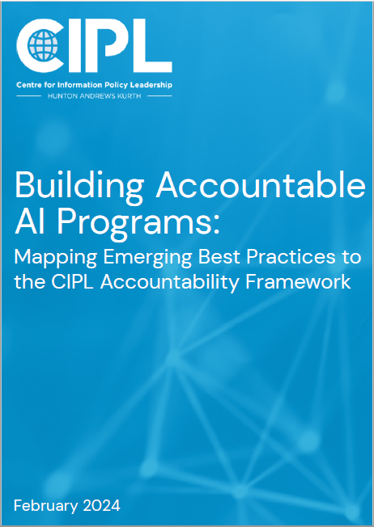

Building Accountable AI Programs: Mapping Emerging Practices to the CIPL Accountability Framework
CIPL Paper 2024
Provides concrete empirical evidence from accountable AI programs being deployed on the ground
Shares best practices and lessons learned from leading global organisations
Builds global consensus on accountability in AI governance
Promotes accountability as an effective strategy for the responsible development and deployment of AI
Informs the global debate on AI regulation, governance, oversight, and enforcement
15

Slide 16
Examples of Best Practices in Accountable AI Programs
Mapped to the CIPL Accountability Elements
Leadership and Oversight
Risk Assessment
Policies and Procedures
“Tone from the top” to demonstrate commitment to ethics, values, and specific AI principles
AI/ethics/oversight boards/committees
Responsible AI lead/officer
Centralised governance framework with flexibility within internal teams
Multidisciplinary, cross-functional AI teams
Developing algorithmic/fairness impact assessments
Requiring risk assessments throughout AI lifecycle
Risk-based approach based on likelihood & severity of risks
Creating risk taxonomy
Documenting considerations & tradeoffs
PETs/anonymisation techniques
Specifying use of protected data in model training
Incorporating “privacy, AI ethics, or security by design” principles
Internal glossary of AI-related terms
Defining escalation steps for reviewing & reporting high-risk AI
Ideation phase with all relevant internal stakeholders
Pilot testing AI models before release
Due diligence/self-assessment checklists for business partners using tools
Translating internal principles into third-party agreements
Cleaning data sets through automated/manual checks before training
Transparency
Training and Awareness
Monitoring and Verification
Response and Enforcement
Tailoring transparency measures for different audiences/contexts
Provide counterfactual information
Factsheets and model cards
Tiered transparency – understanding customers’ expectations and deploying based on their readiness to embrace AI
Considering accessibility needs
Benchmarking opportunities, public engagement, regulatory sandboxes
Focused ethics training for technicians (e.g., limiting & addressing bias)
Cross-functional training (e.g., privacy professionals and AI engineers)
Incentivising compliance with ethics training (e.g., promotions, bonuses, pay raises)
Compilation of AI case studies
Tailored ethics & fairness training
Ongoing monitoring, validation & checks throughout AI lifecycle
Human in the loop in design, oversight & redress
Human audit of input & output
Red-teaming & adversarial testing
Monitoring the data ecosystem
Understanding where AI is being deployed
Human review of individual decisions
Redress mechanisms to remedy AI decisions
Internal supervision of AI deployment
Redress through a human, not a bot
Communication channels for internal (e.g., employees) & external (e.g., end users, customers, regulators) reporting, feedback, complaints, requests

Slide 17
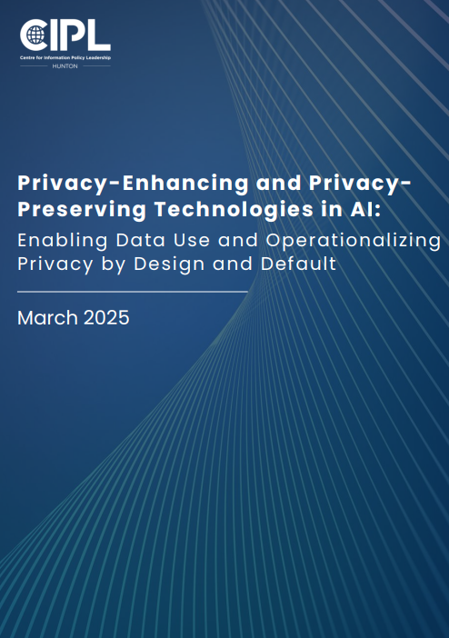

Accountability Includes PETs and PPTs in AI
CIPL Paper 2025
Provides an in-depth exploration of how PETs are being deployed to address privacy within AI systems
Describes how these technologies can help operationalize privacy by design and default and serve as key business enablers
Demonstrates how PETs can address challenges and provide new opportunities across the AI life cycle
Uses real-world case studies to illustrate practical application and benefits

Slide 18
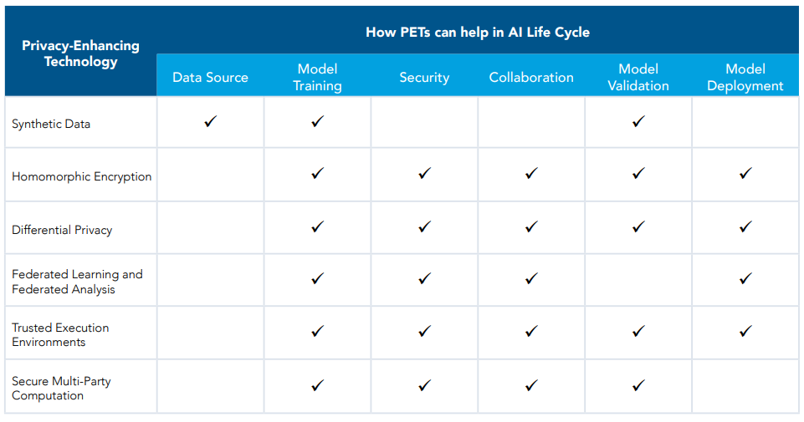
How PETs can help in AI Life Cycle

Slide 19
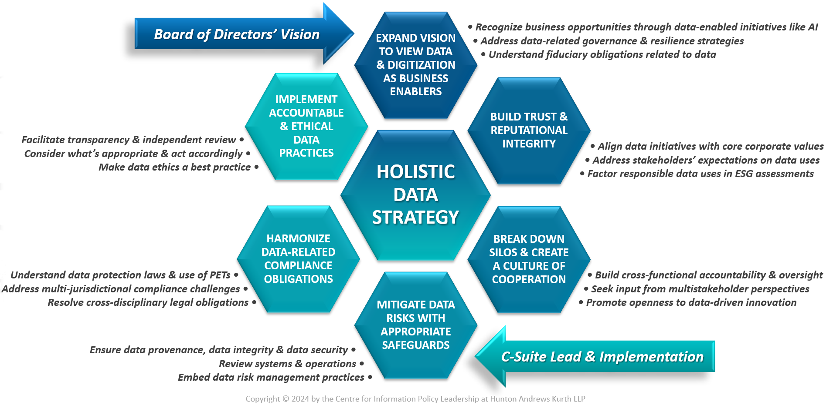
Roadmap for a Holistic Data Strategy
19

Slide 20
3. Smart regulators – effective, dual role and outcomes-based

Slide 21

Smart Digital Regulators
Effective regulators have to evolve in the new digital world
Strategic, prioritized, risk-based, transparent and outcomes-based regulatory policy
  Prioritised activities (leadership, enforcement, complaint handling, authoriser)
  Innovative regulatory methods (e.g. Regulatory sandbox, innovation hubs)
Constructsive engagement with regulated organisations
  Maximum consultation, participation and frank exchanges
Incentivize and encourage accountability
  Showcase best practices, accountability efforts and PETs; differentiating factor in enforcement
Act in a connected way with other digital regulators
  Consistent regulatory guidance and approaches, mutual cooperation
Build bridges with different regimes
  Accountability frameworks (e.g. APEC CBPR and EU BCR)
  Mutual recognition

Slide 22
Emerging Priorities for all Stakeholders
1. Proportionate and risk-based regulation; evolving interpretation of DP principles; smart regulatory oversight
2. Balancing data protection with other rights and regulations
3. Considering the benefits of AI, loss of opportunity, as well as risks
4. Investing in Accountability, responsible practices and PETs as key drivers of business success, trust, and competitive advantage

Slide 23


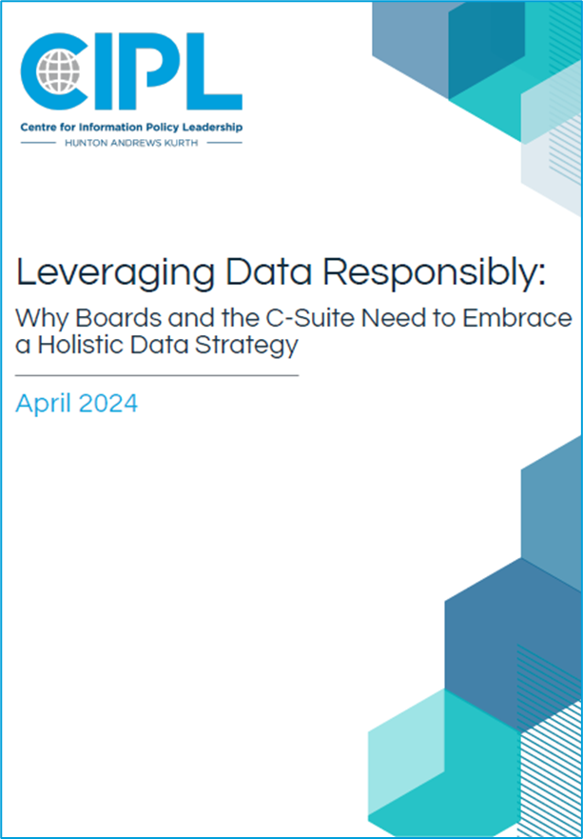
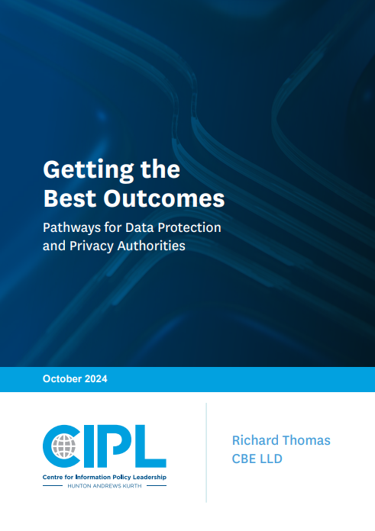




CIPL Key Resources
Accountability Mapping Report
2020
Data Sharing
Between Public
and Private Sectors
2023
Accountable AI Programs
2024
Embracing a Holistic Data Strategy
2024
Pathways for Regulators to get the Best Outcomes
2024

Slide 24


Thank you
Bojana Bellamy
President CIPL
bbellamy@hunton.com
Centre for Information Policy Leadership
www.informationpolicycentre.com
Hunton Privacy and Information Security Law Blog
www.huntonprivacyblog.com
@THE_CIPL linkedin.com/company/centre-for-information-policy-leadership

