Slide 1
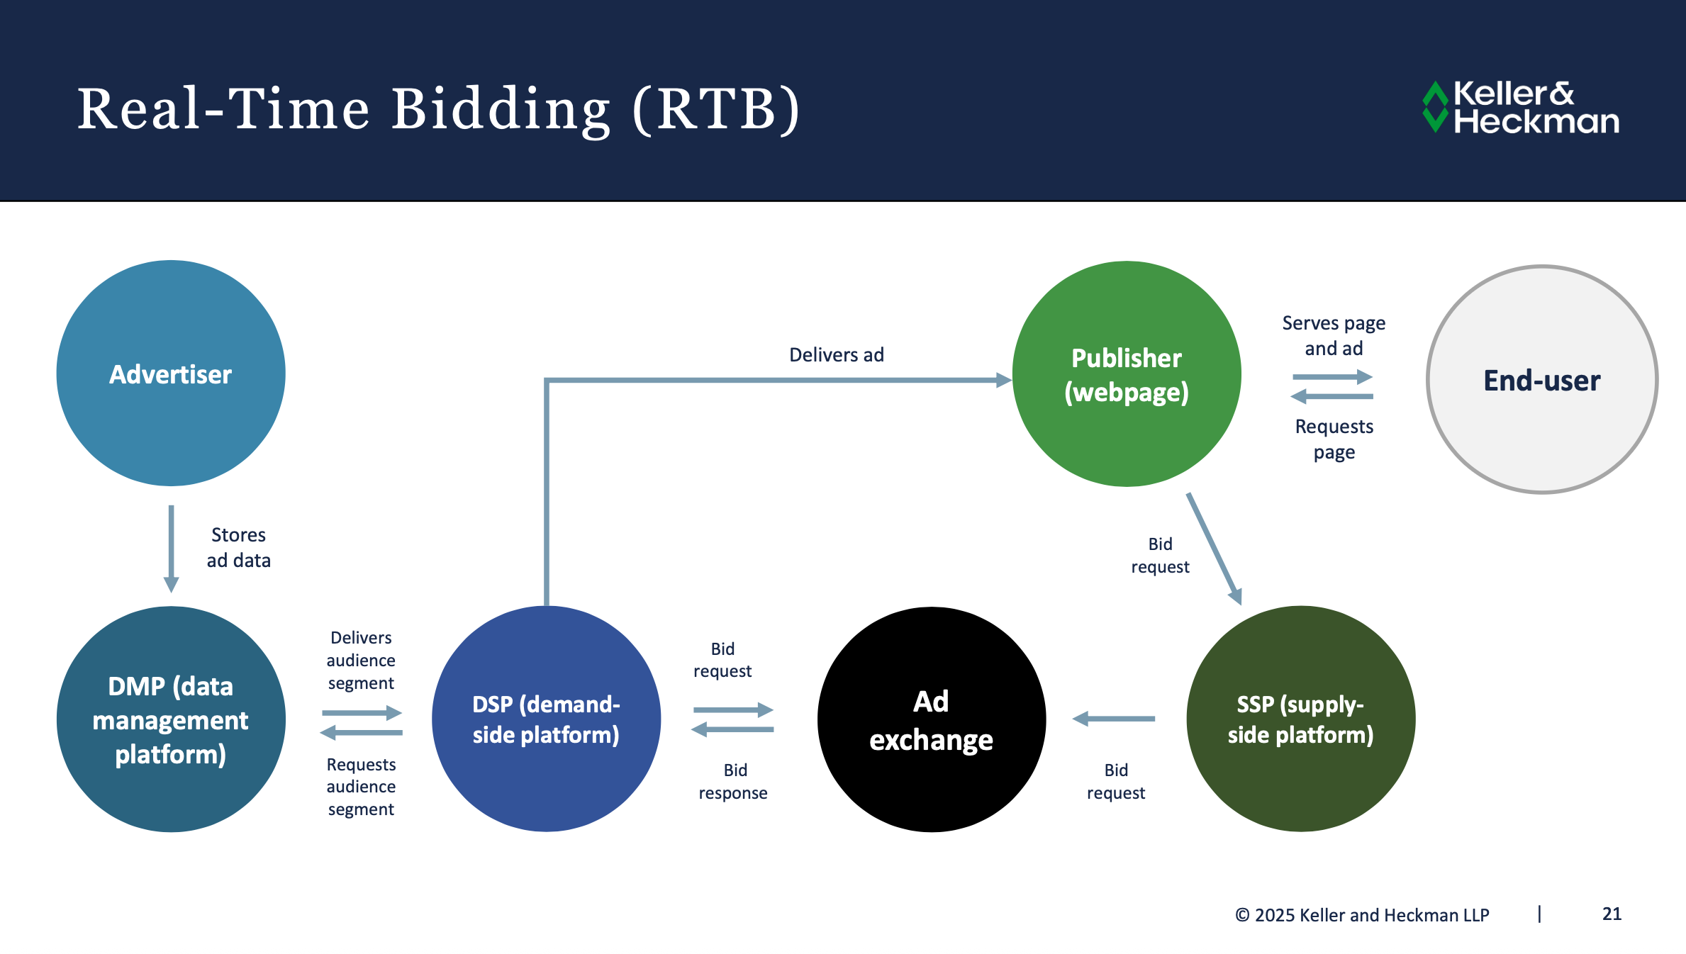

Slide 2
Power of 3: Baltics combined are between Portugal & Greece
41,159
Note: All data in constant 2023 EUR.

Slide 3
On a per capita basis, Baltic digital ad markets are more developed than other markets in the East of Europe
Average Ad Spend per Capita
Digital ad growth 2024 (YoY)
European growth
Note: Excludes Turkey as no meaningful analysis possible.
Digital ad spend per capita (adjusted for PPP)

Slide 4
Baltics overindex on classic display & classifieds, signalling potential for market transformation
Note: Indiviudual categories cannot be summed to a 100% due to double counting (e.g. video, social video, non-social video)

Slide 5
Video channels are the key growth drivers in the Baltics
Total Baltics digital ad market growth

