Slide 1
What’s at Stake?
The Baltics, Europe and the Agentic AI Revolution
Luukas Ilves
Baltic Privacy and Innovation Summit
June 5, 2025

Slide 2
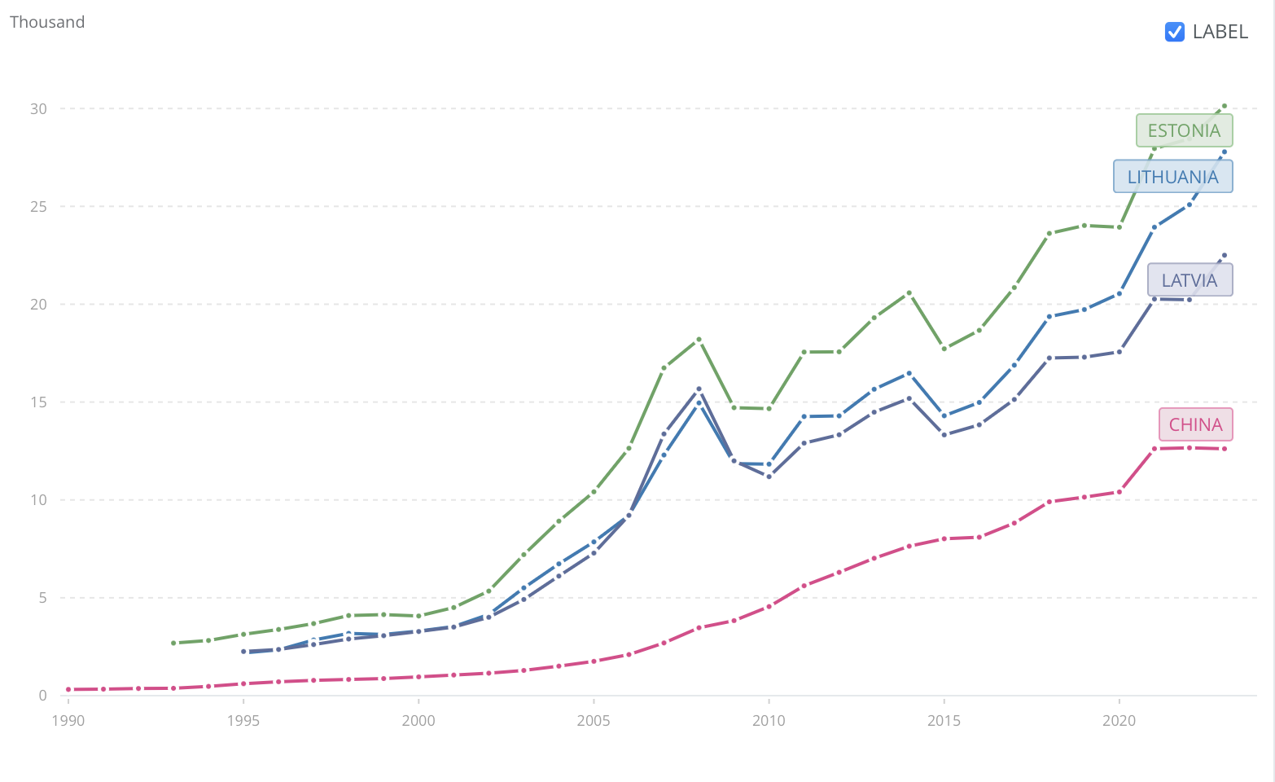

Slide 3
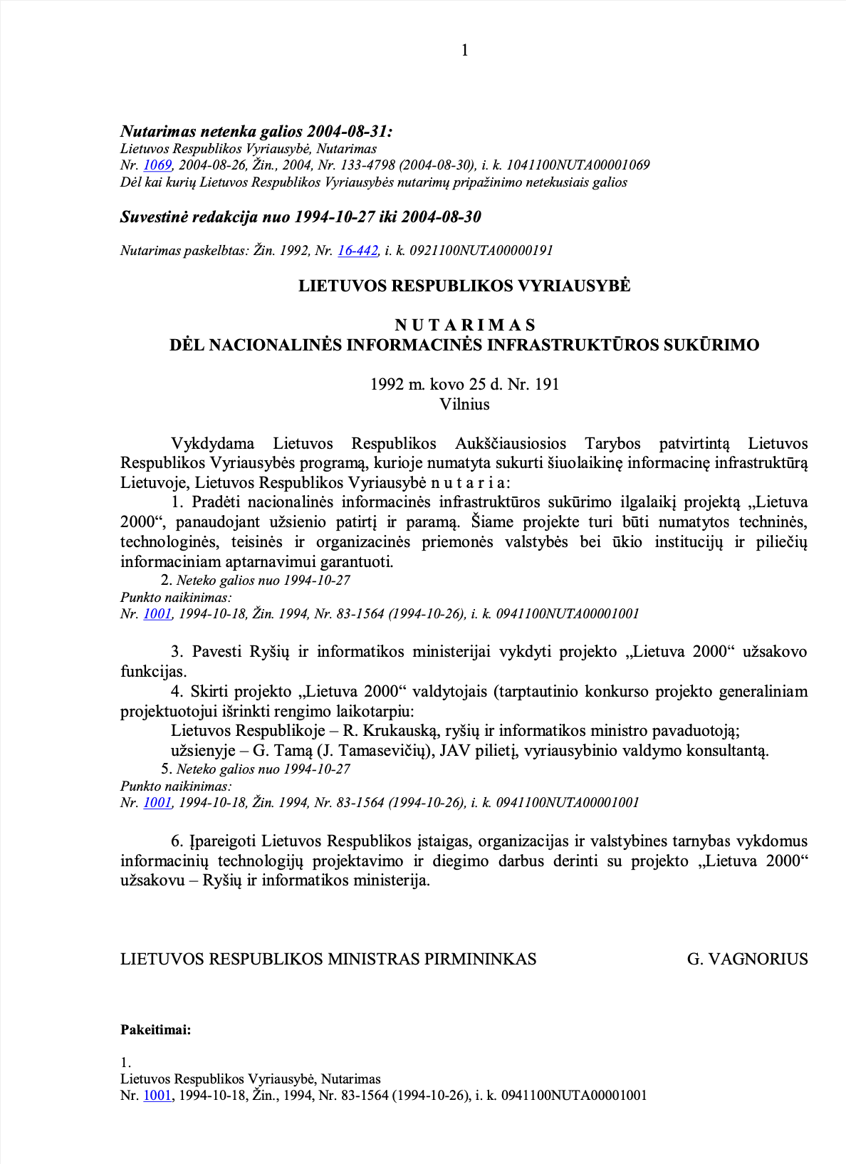
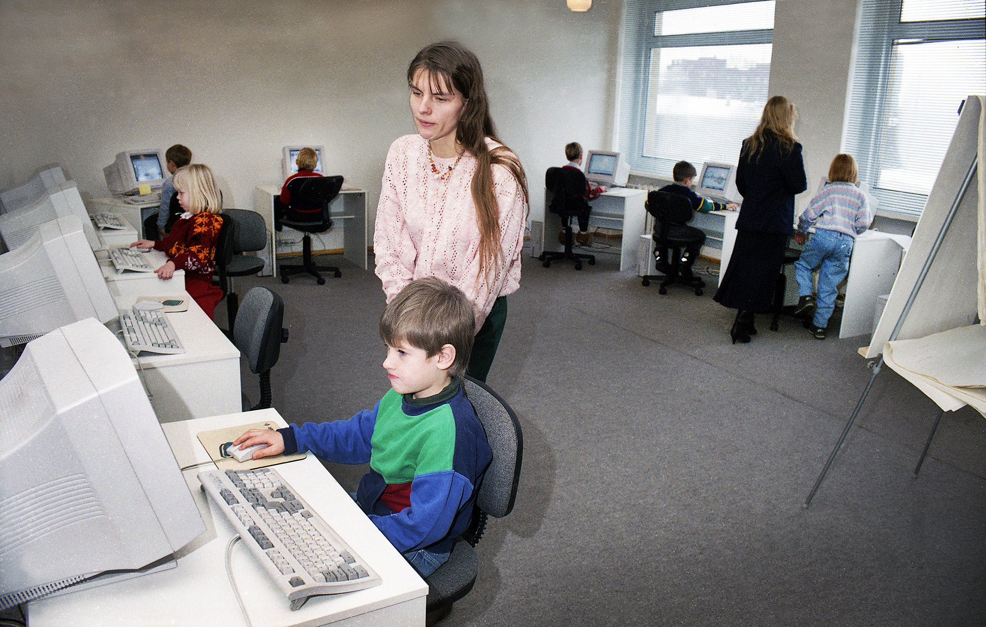

Slide 4
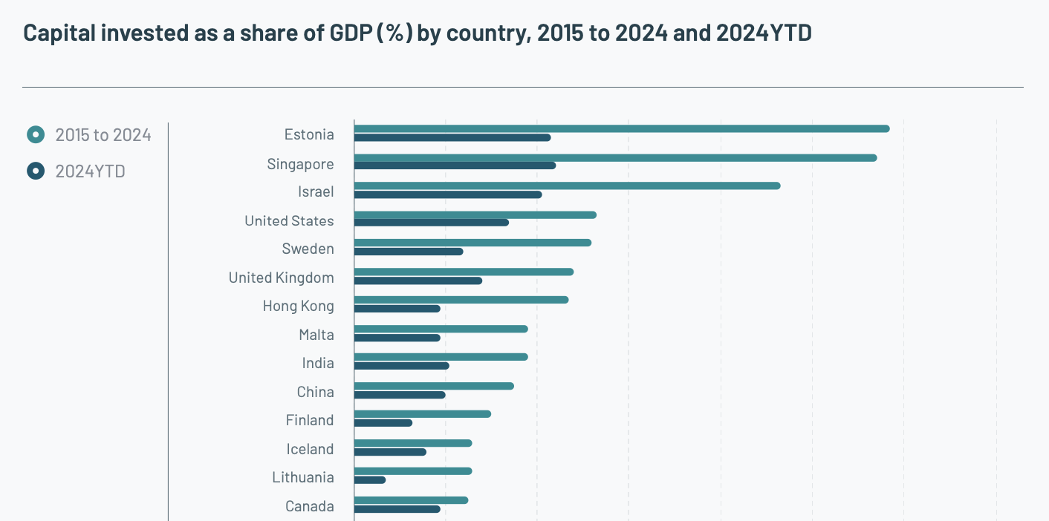

Slide 5
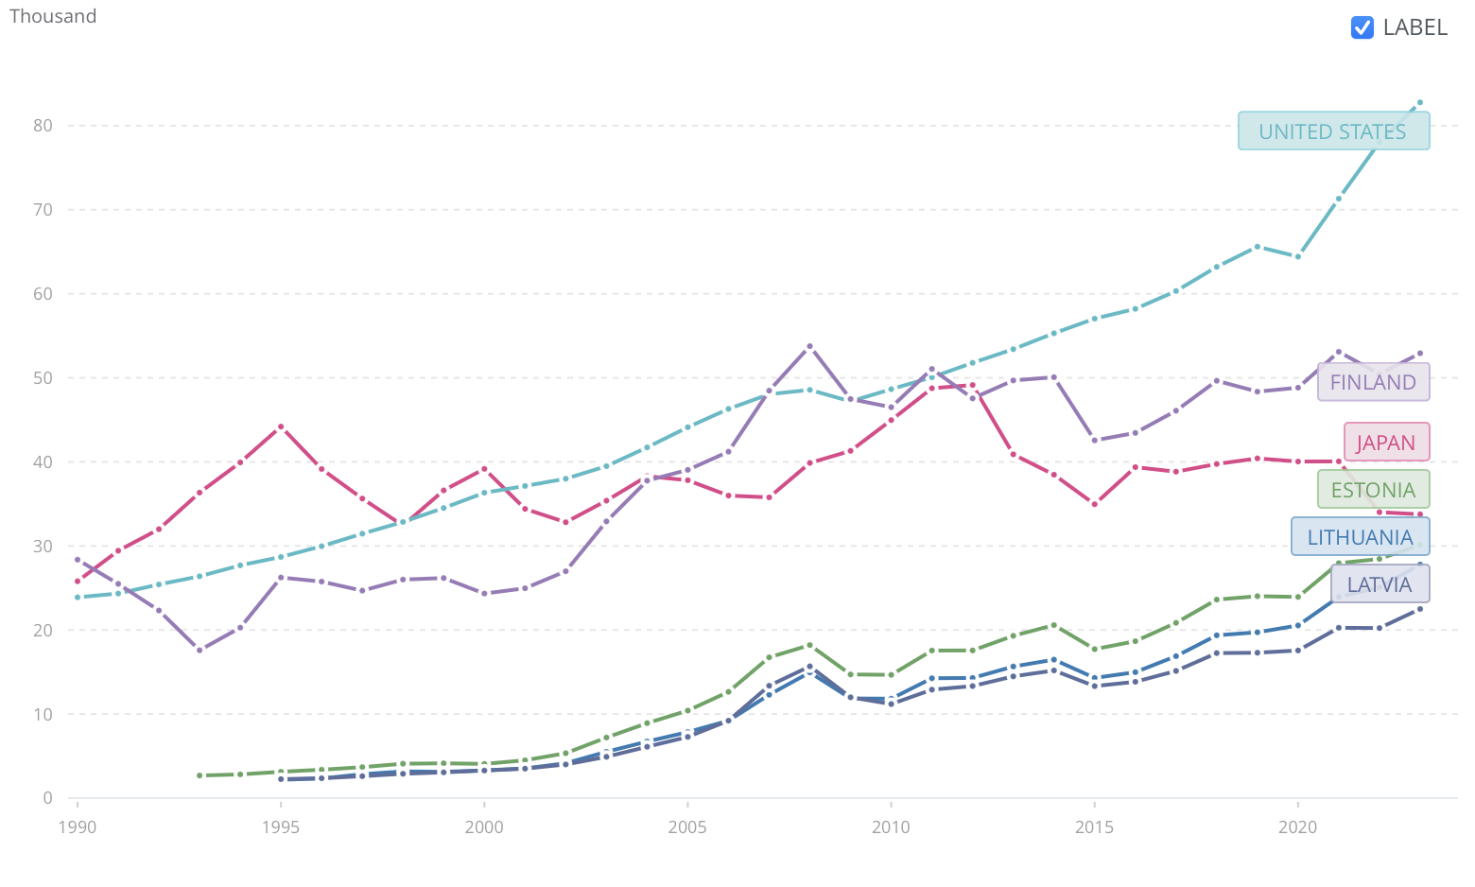

Slide 6
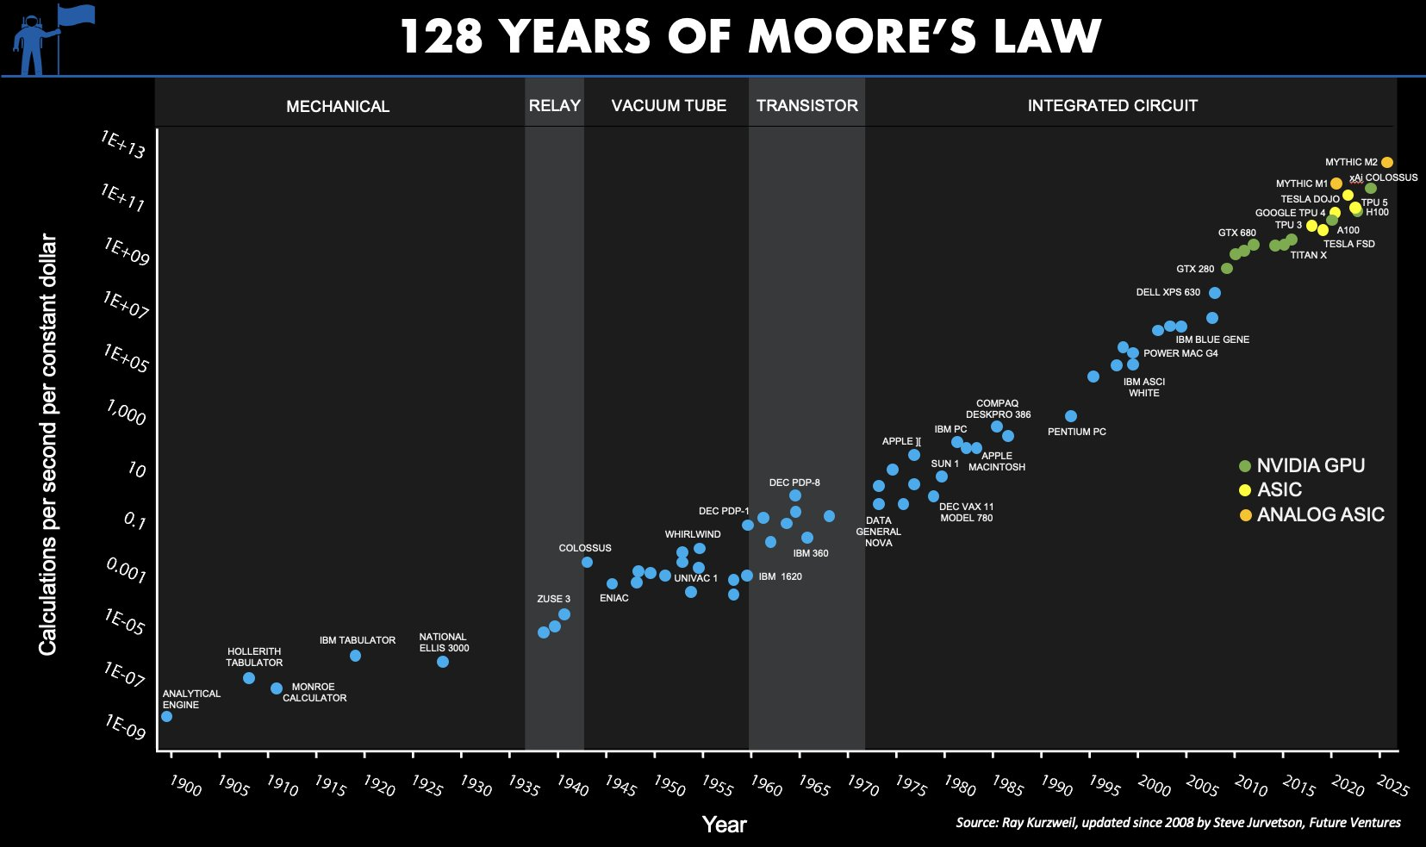

Slide 7
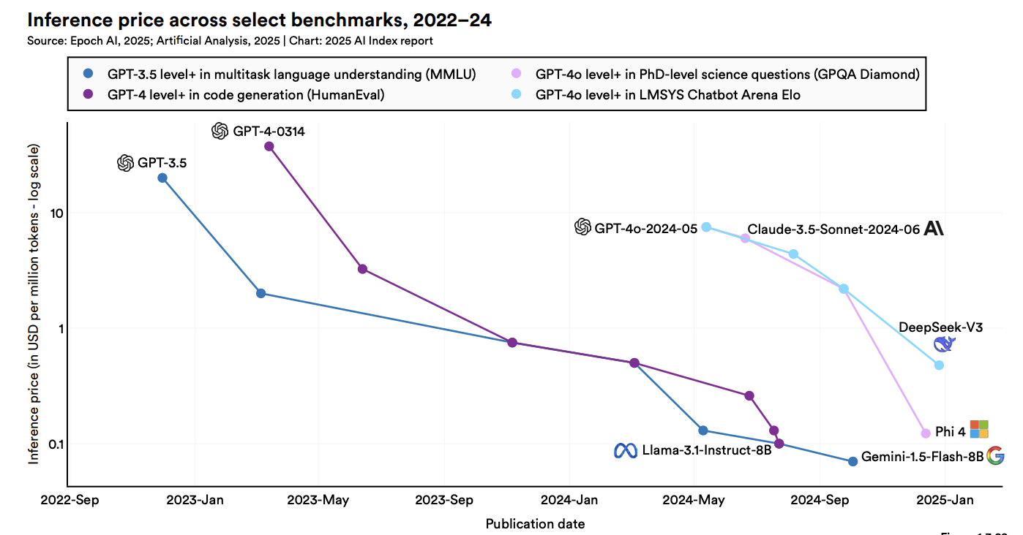

Slide 8
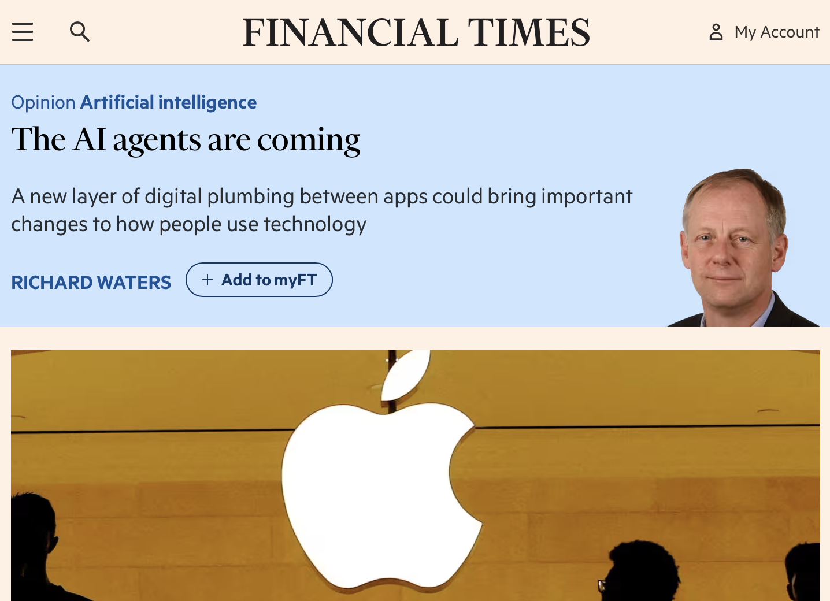
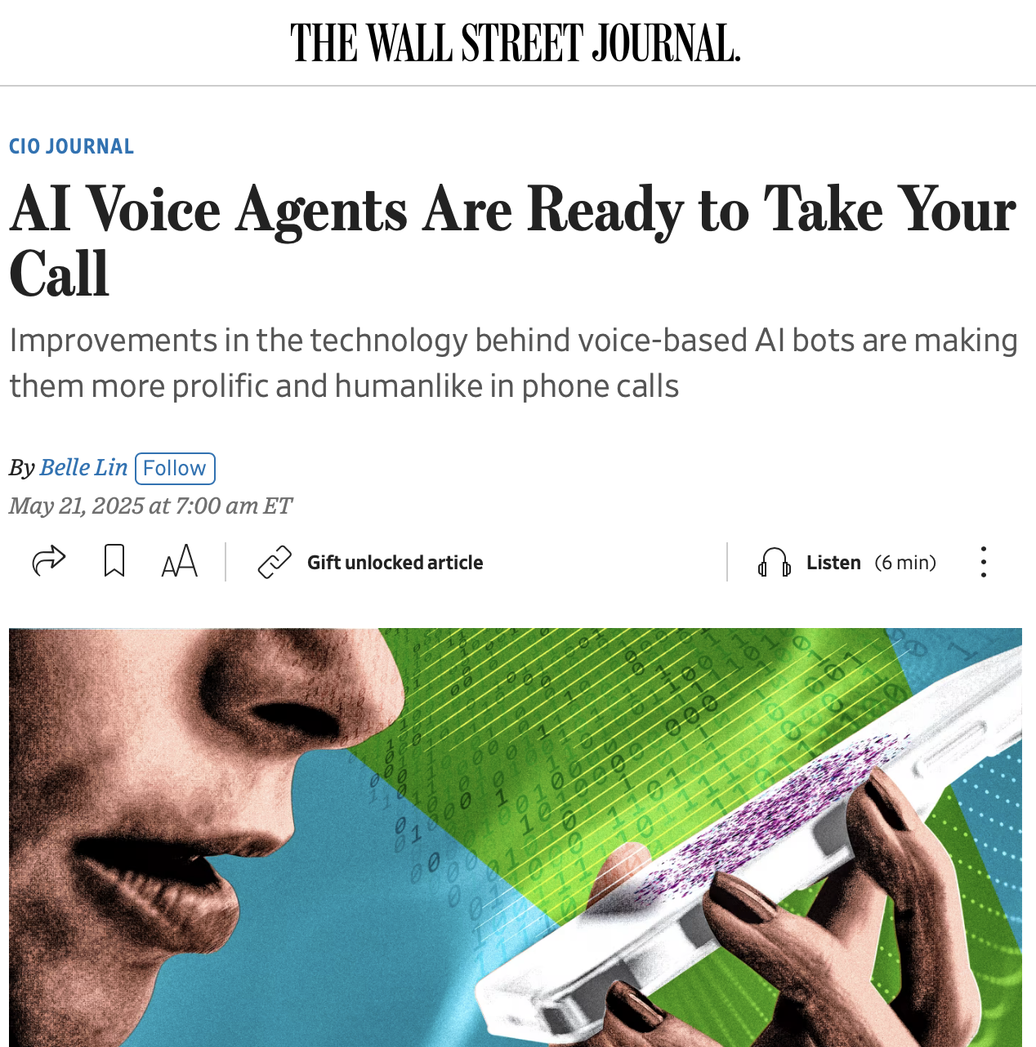
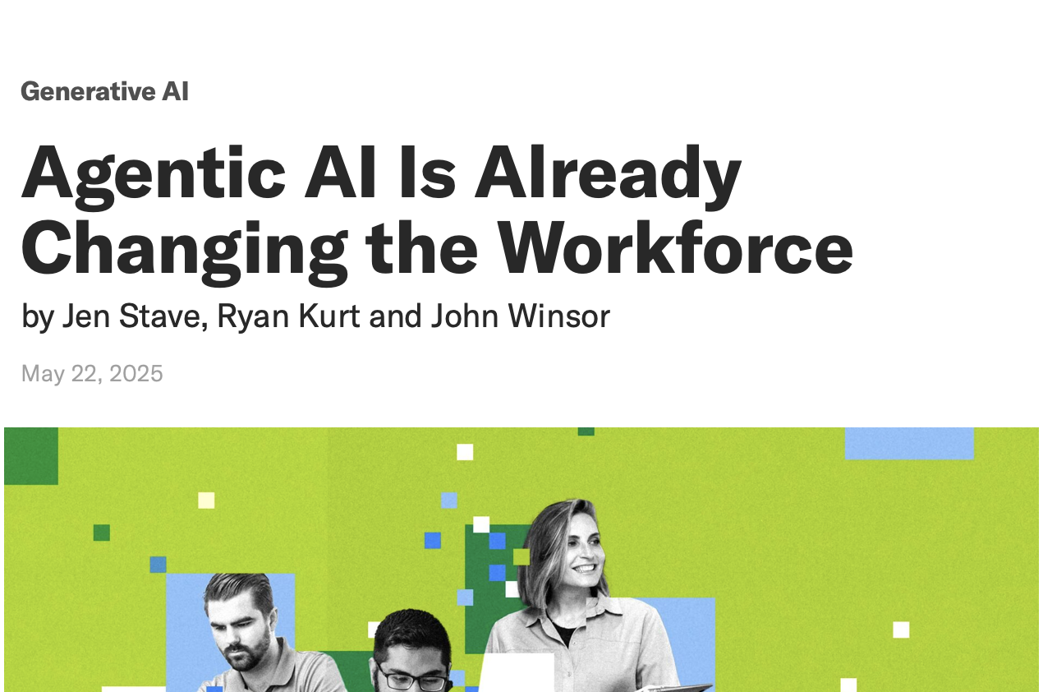
Trends: AI agents

Slide 9
Agent Type | Description | Examples
Information and Analysis | These agents specialise in gathering, processing, synthesising, and analysing information from diverse sources. Their primary function is to provide insights, answer complex queries, make comparisons, or offer decision support. | Agents performing product comparisons by browsing the web or personalised agents assisting individuals in making complex decisions, such as selecting insurance plans or educational institutions.
Task Execution and Automation | These agents are designed to perform specific actions and automate workflows within digital (and sometimes physical) environments. They follow instructions or pursue defined goals to complete tasks. | Agents that buy goods online, book flights, conduct software engineering tasks, or provide office support by managing schedules and documents.
Interaction and Communication | These agents focus on engaging with humans or other AI agents. Their capabilities centre on natural language understanding, dialogue management, negotiation, and facilitating collaboration. | Agents capable of making phone calls or engaging in complex interactions with other agents using specialised communication protocols to coordinate activities or make agreements.

Slide 10
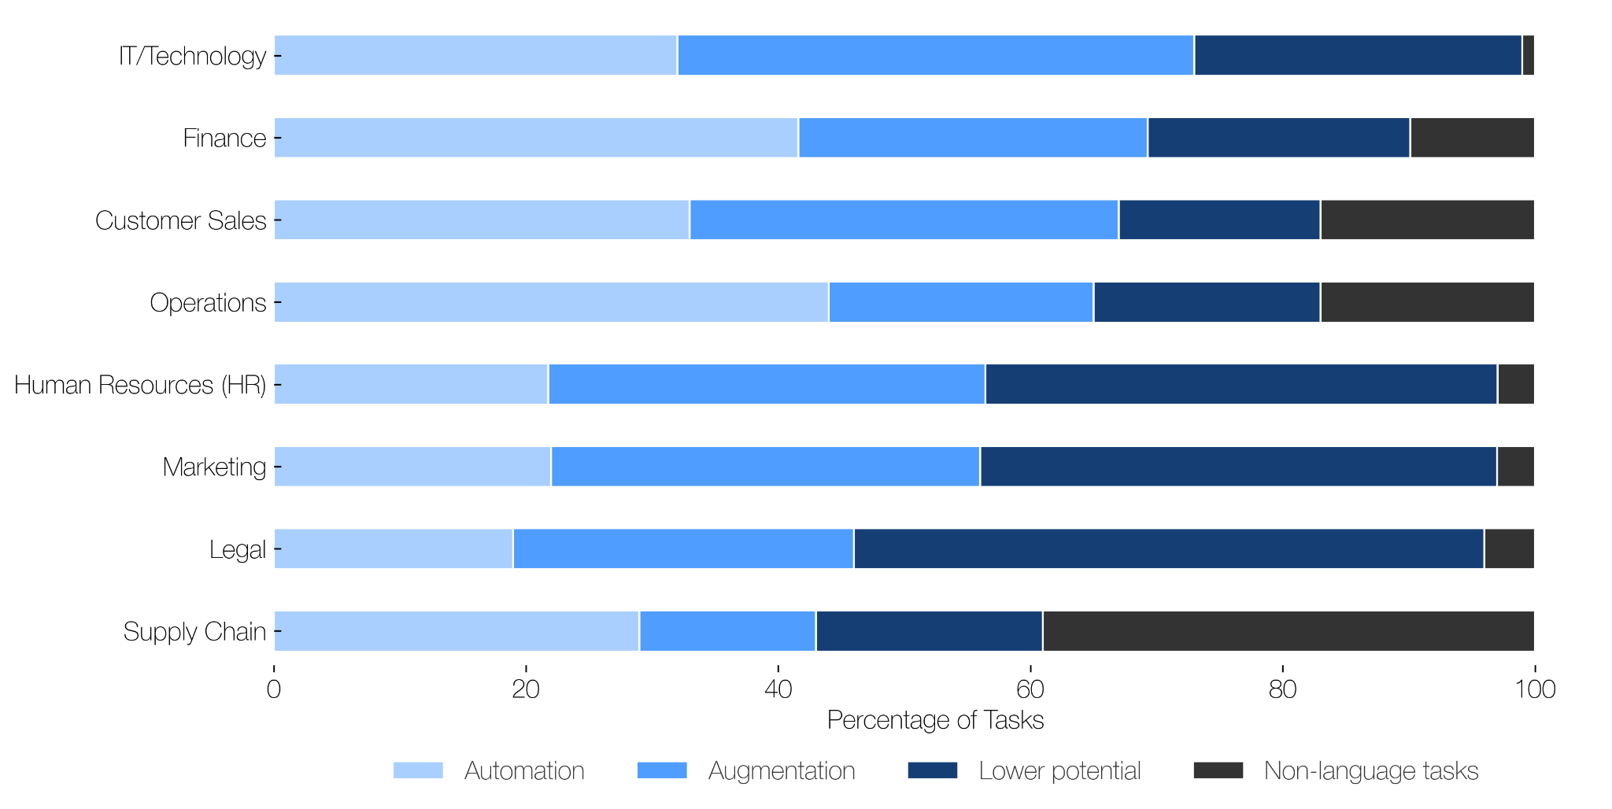
Job function groups with the highest exposure to generative AI

Slide 11
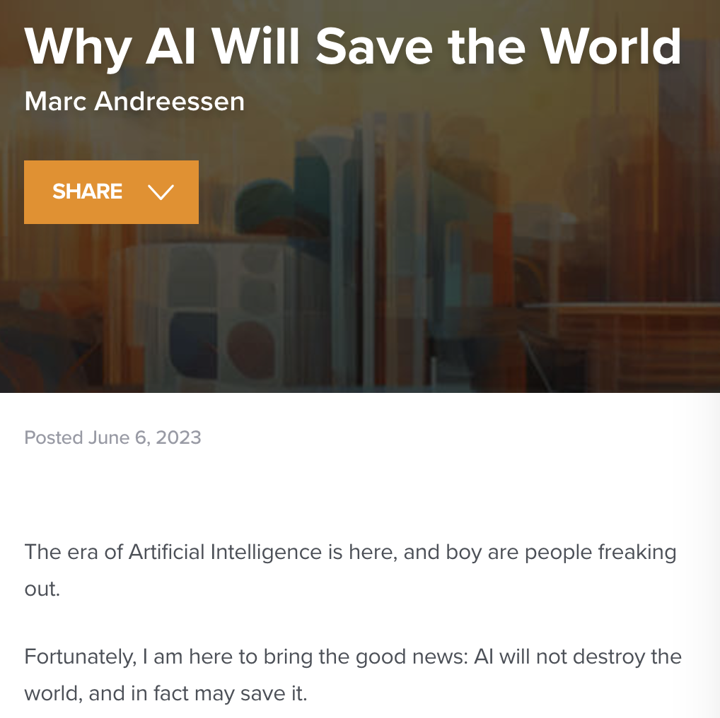
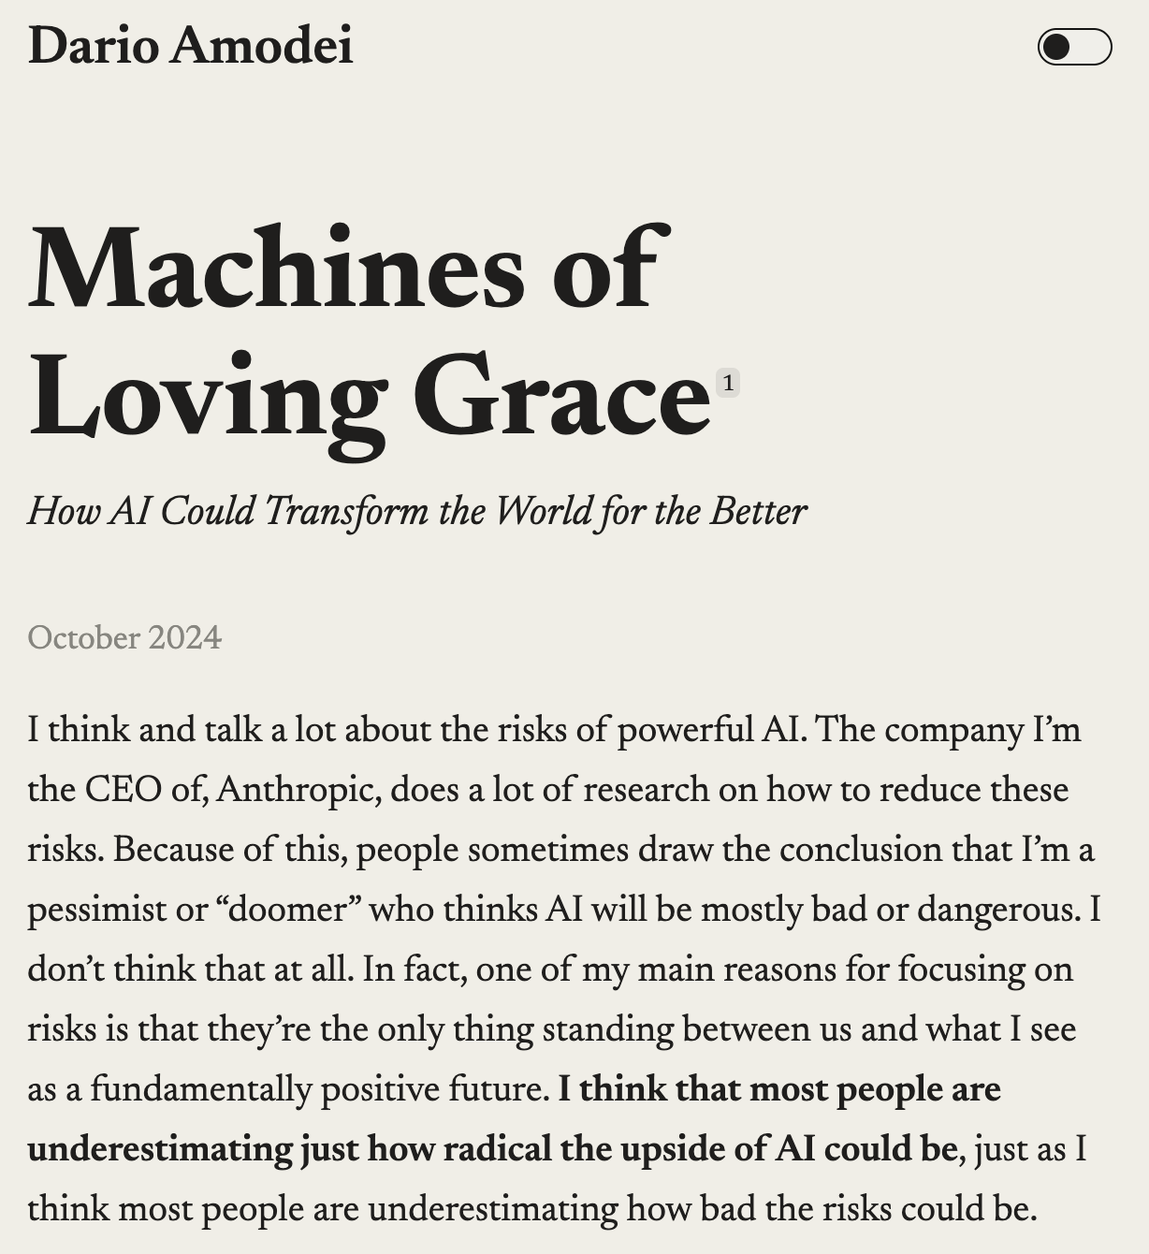

Slide 12
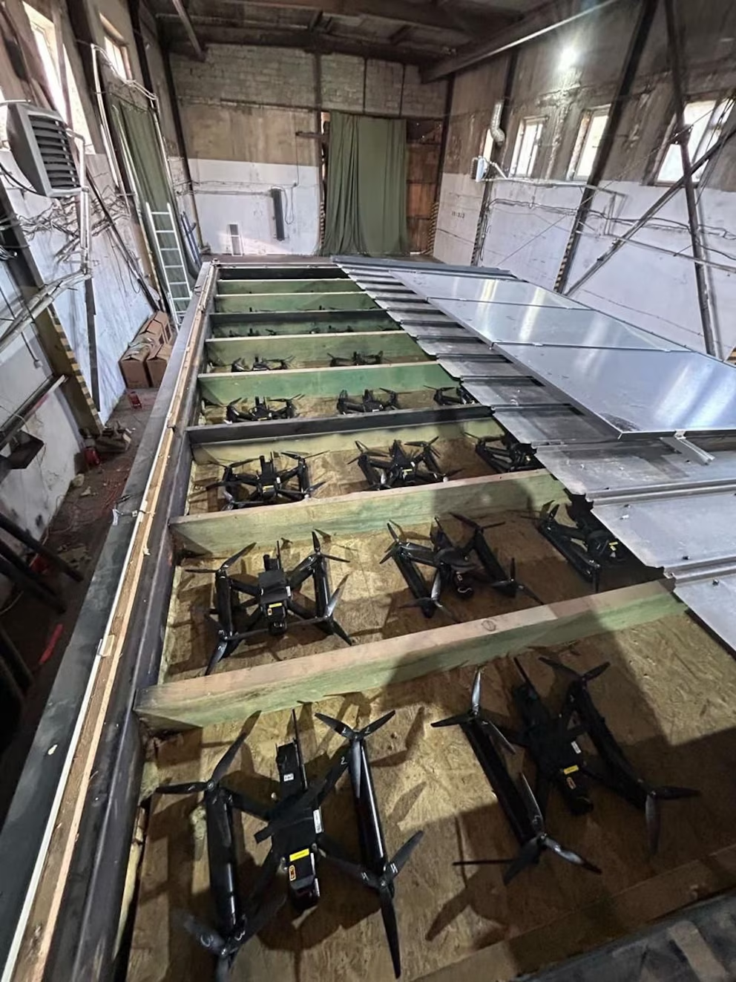
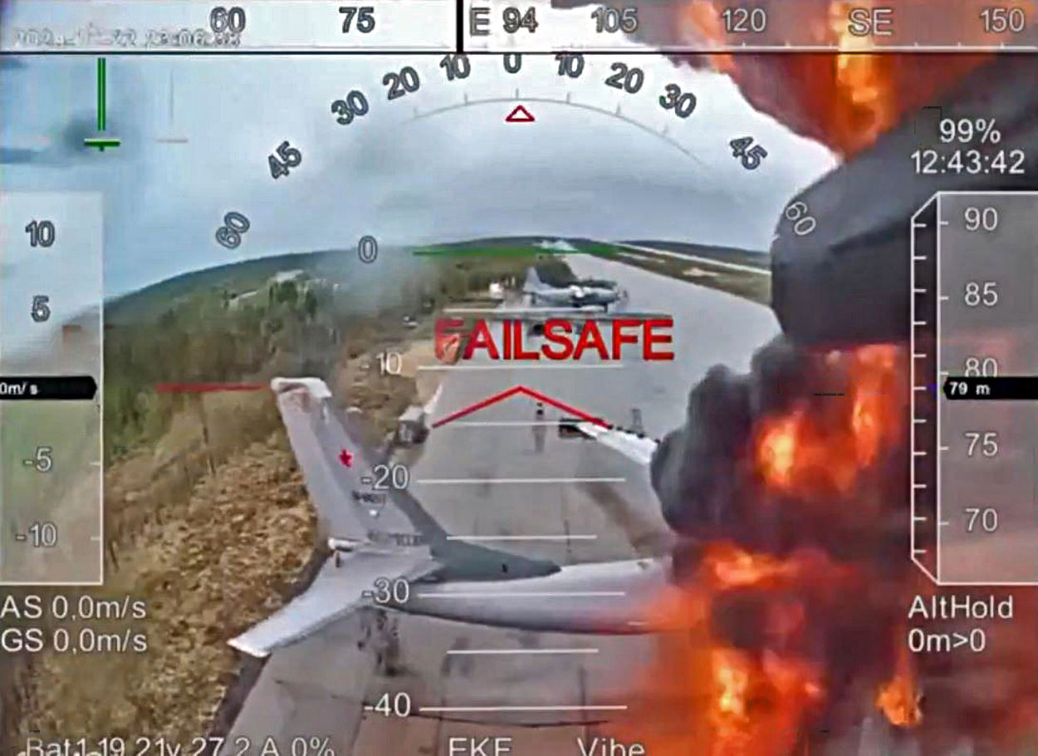

Slide 13
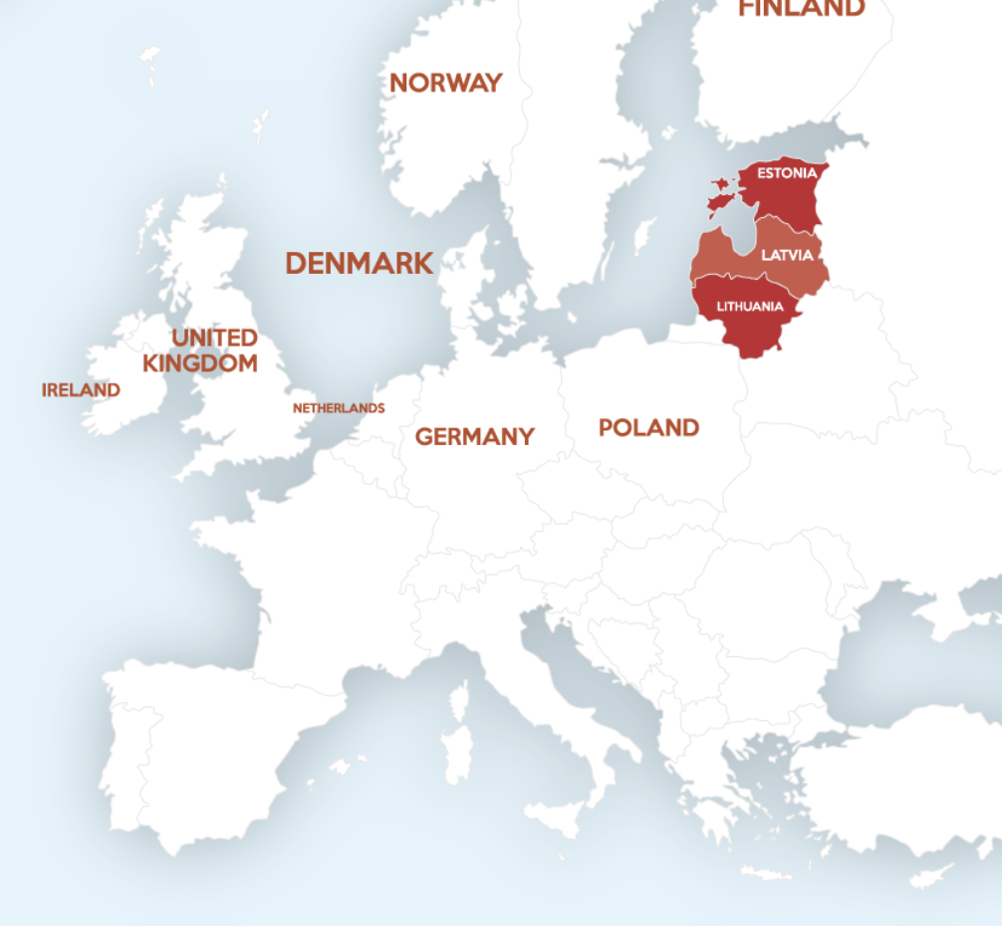
So where does that leave us?

Slide 14
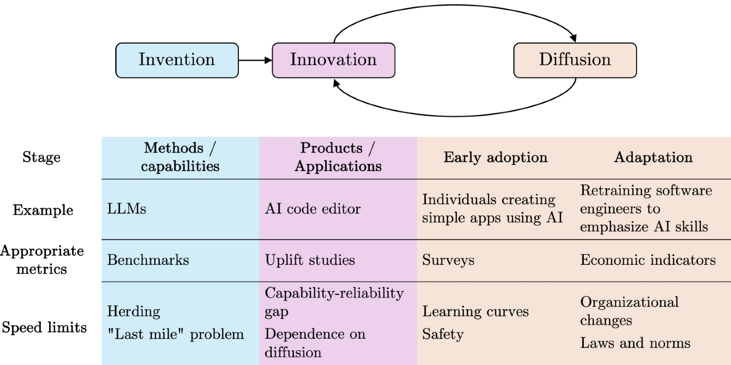
AI as a “normal” technology

Slide 15
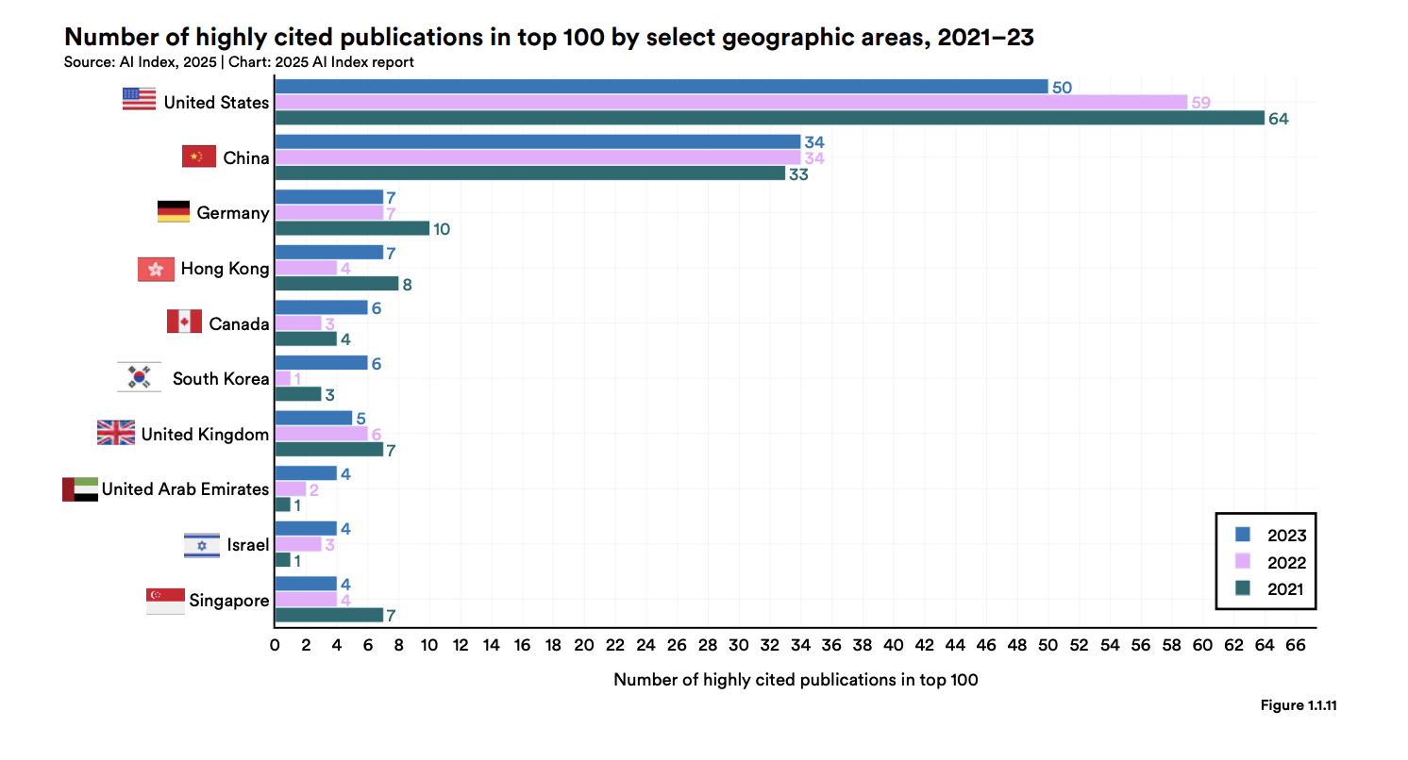

Slide 16
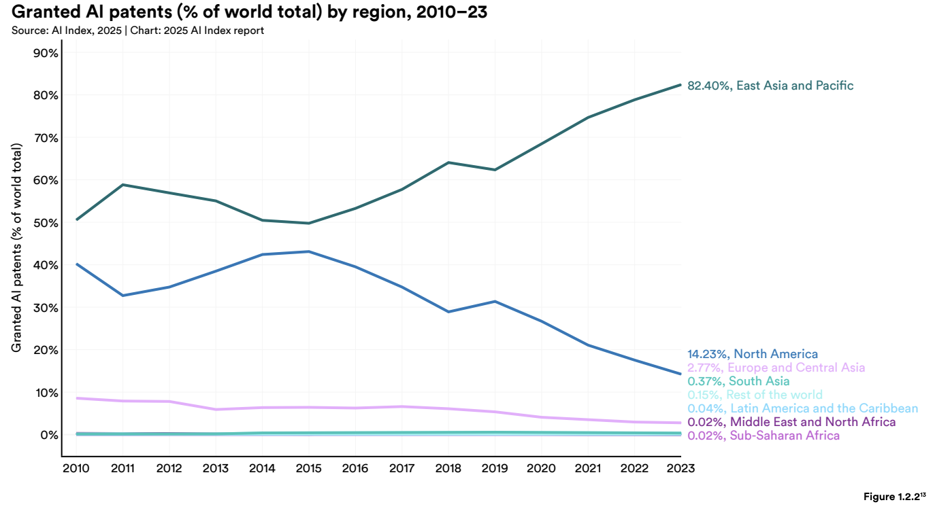

Slide 17
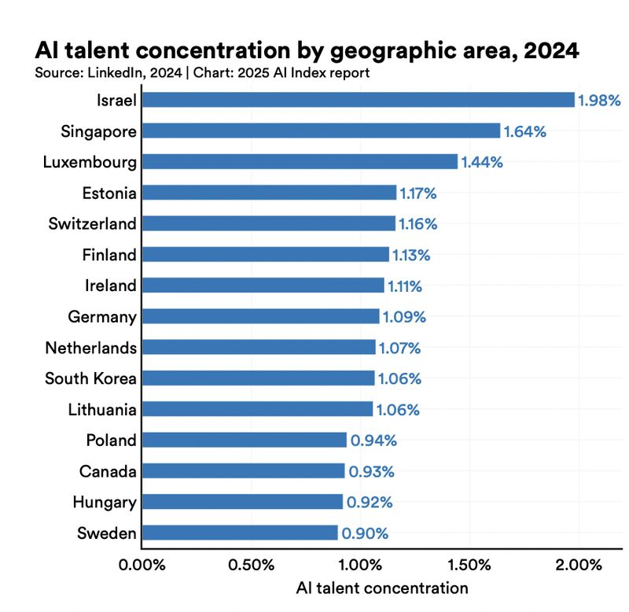
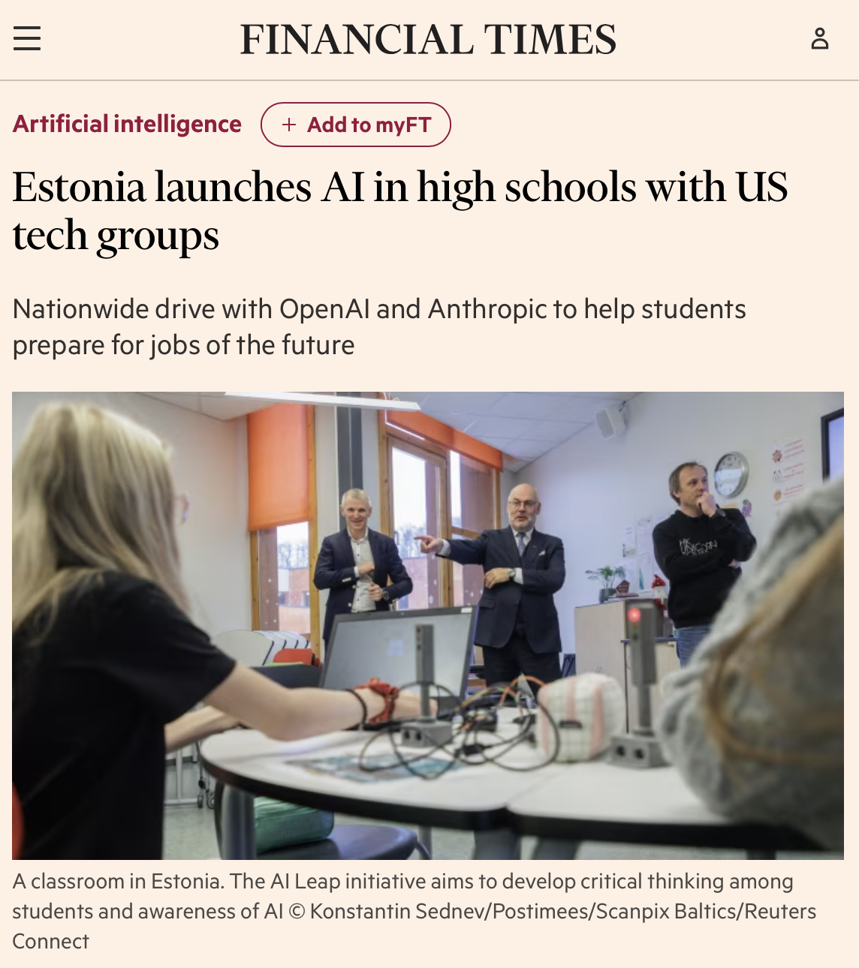

Slide 18
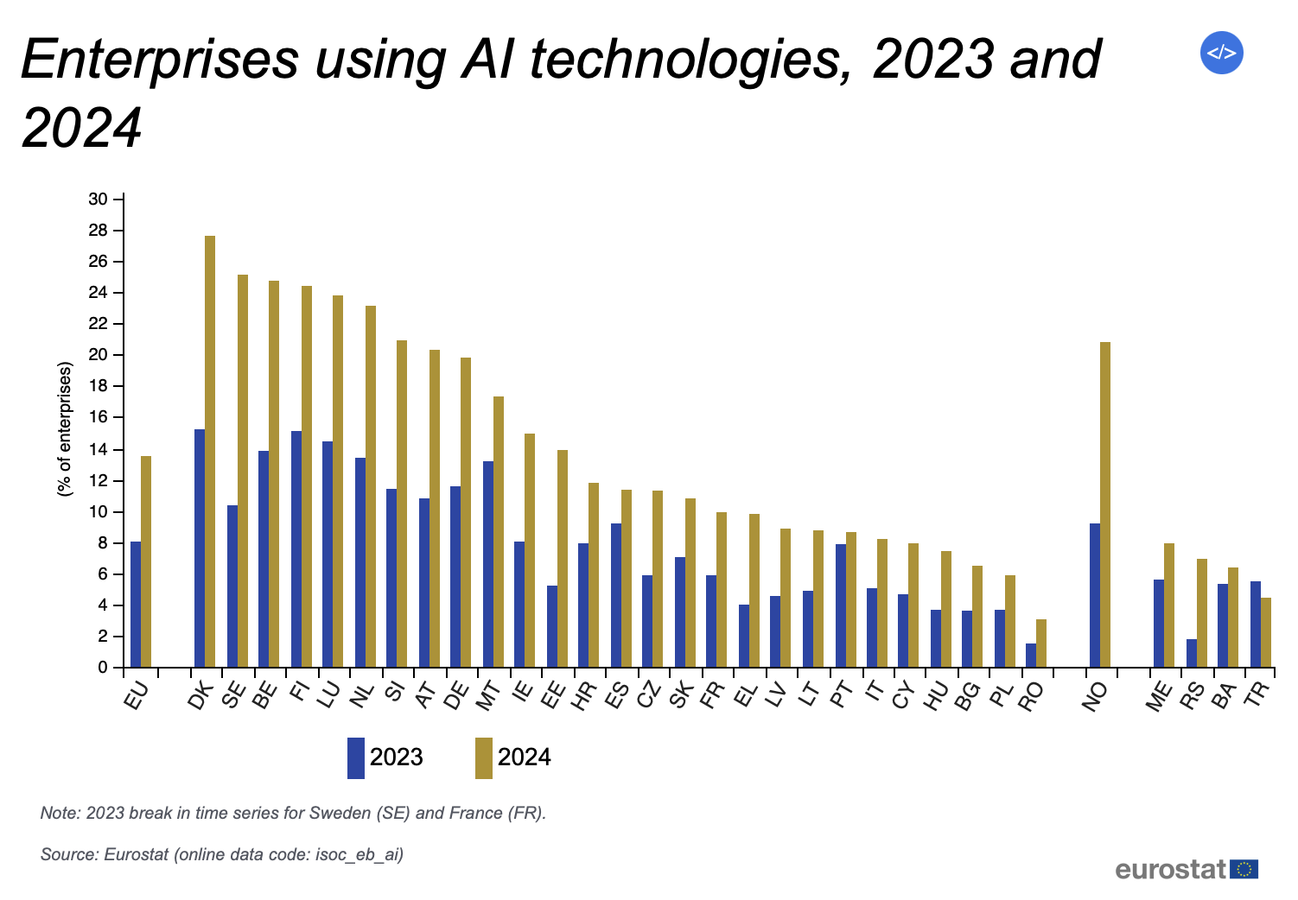

Slide 19
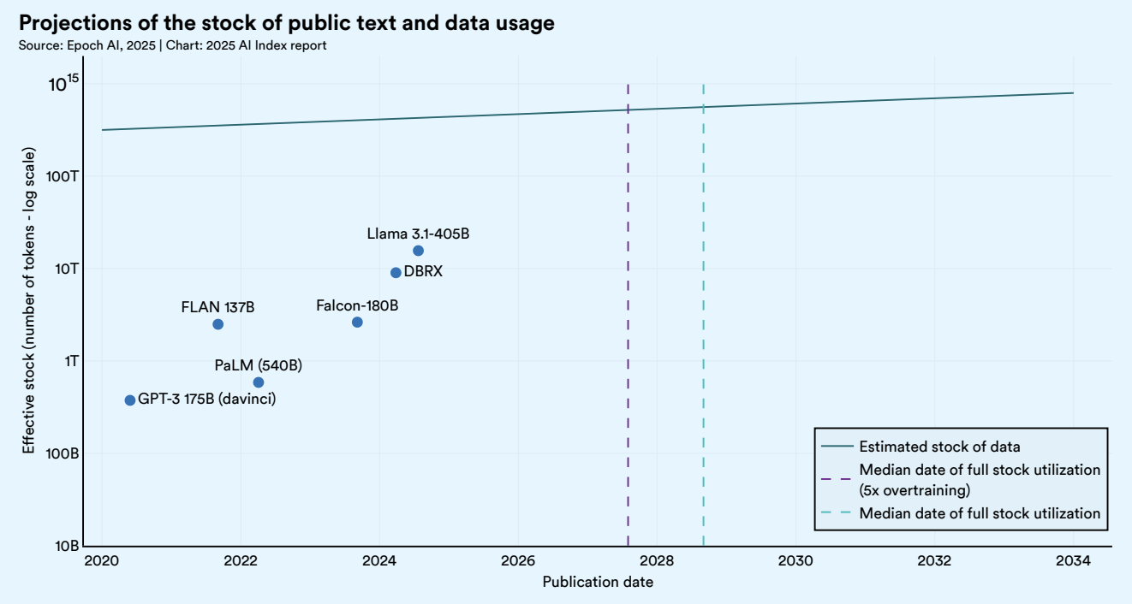
Data and automation

Slide 20
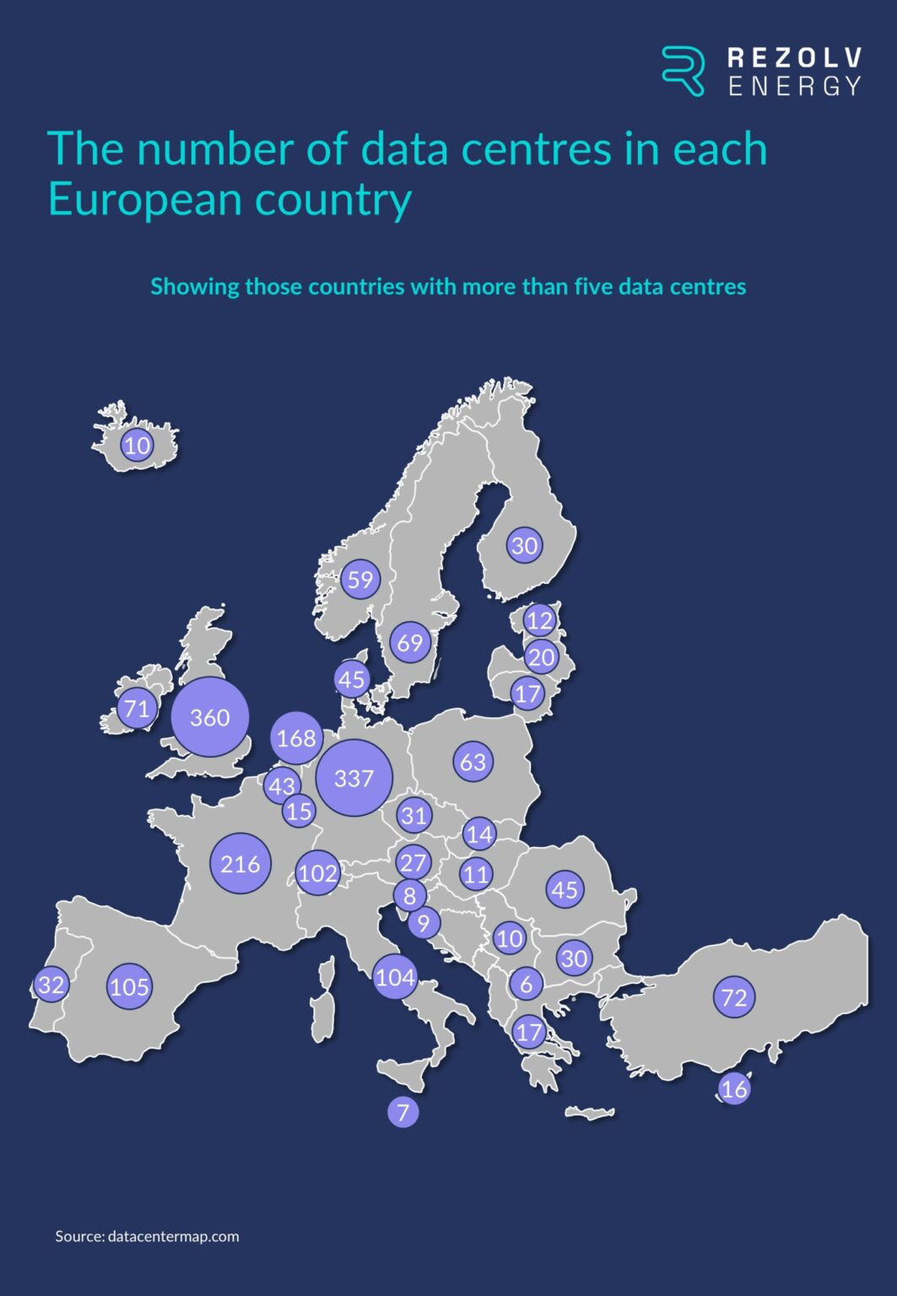
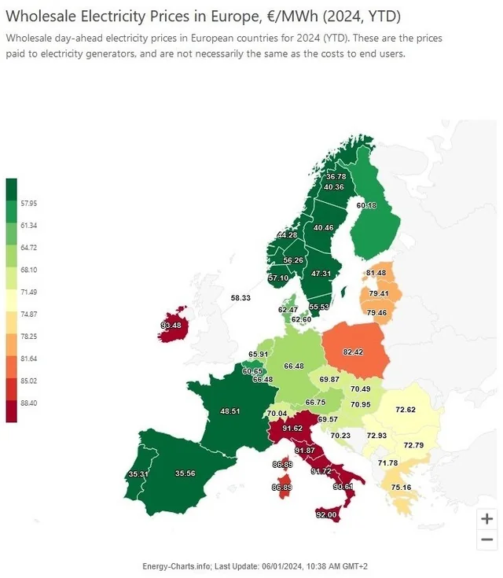

Slide 21
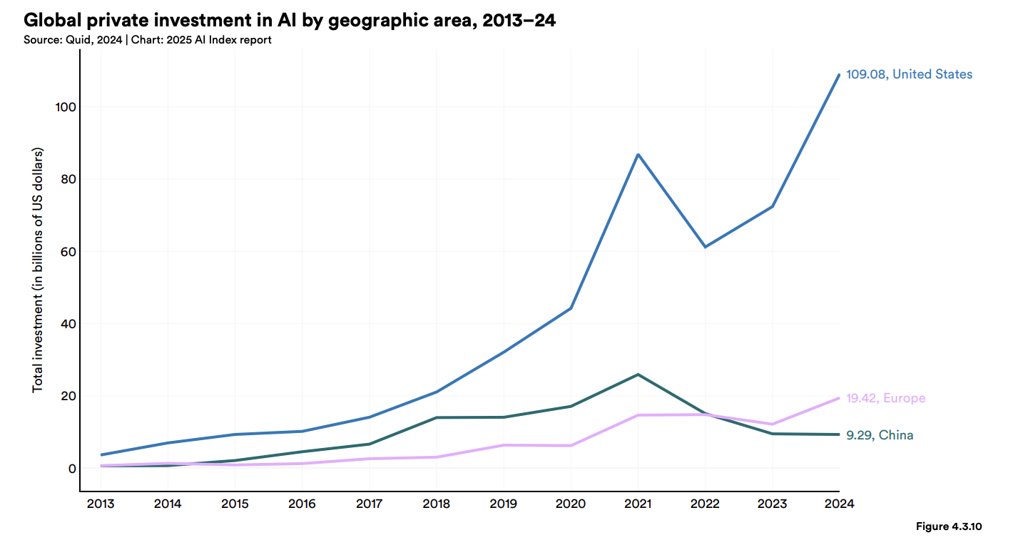

Slide 22
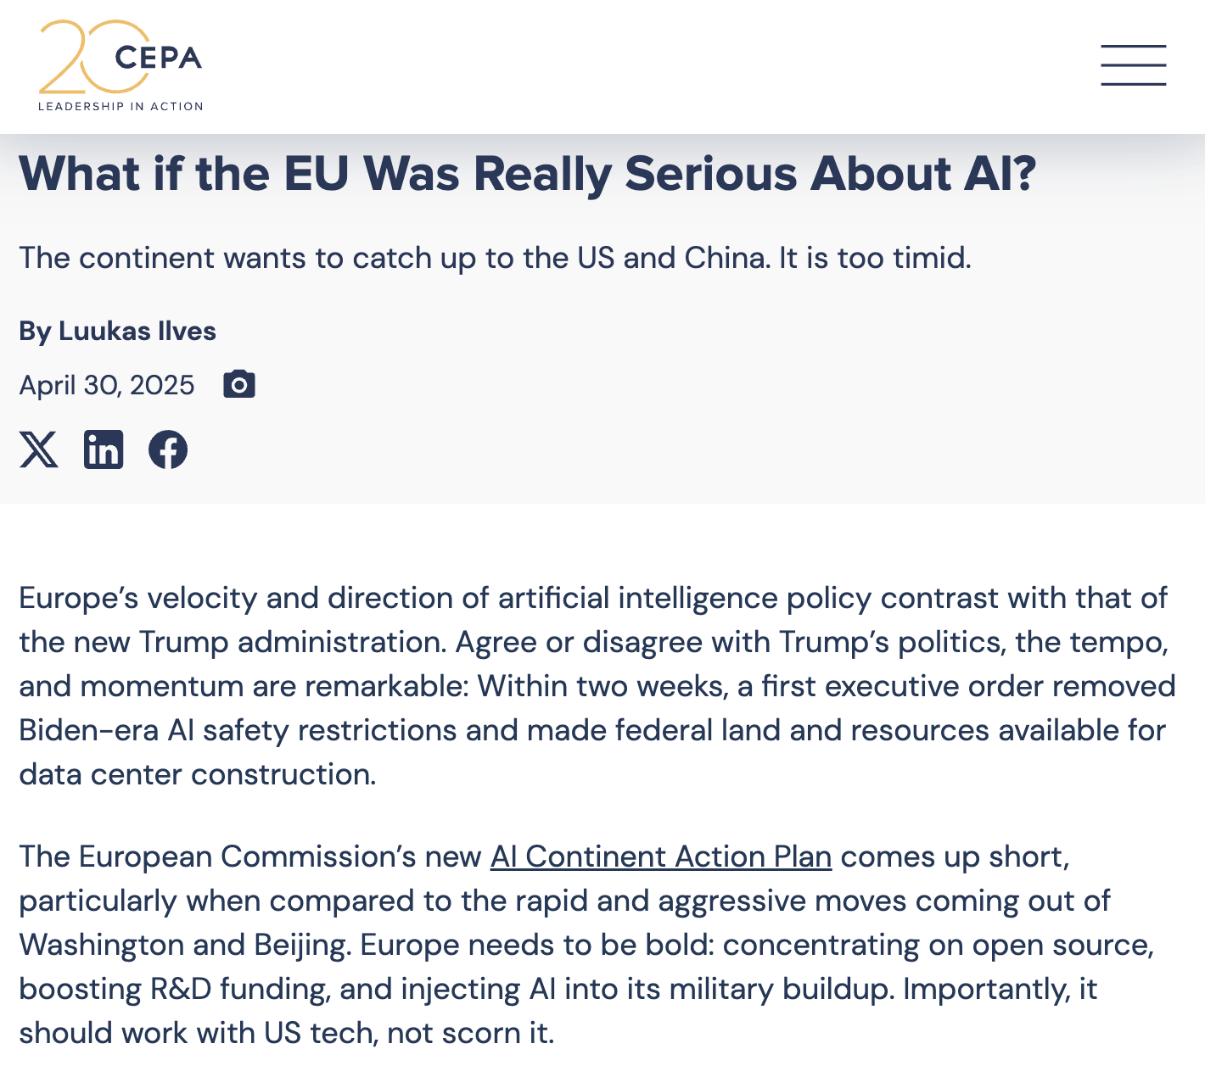

Slide 23
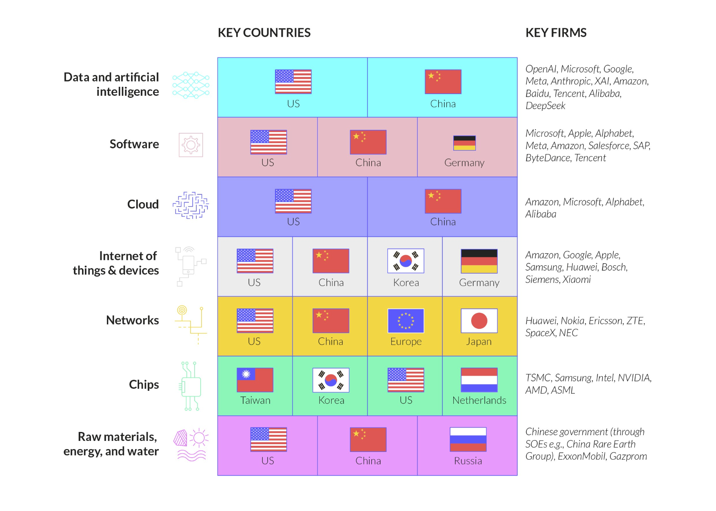
Eurostack?

Slide 24
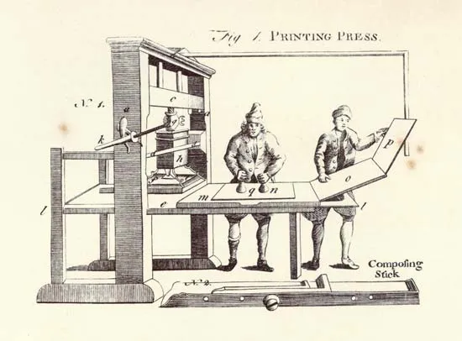
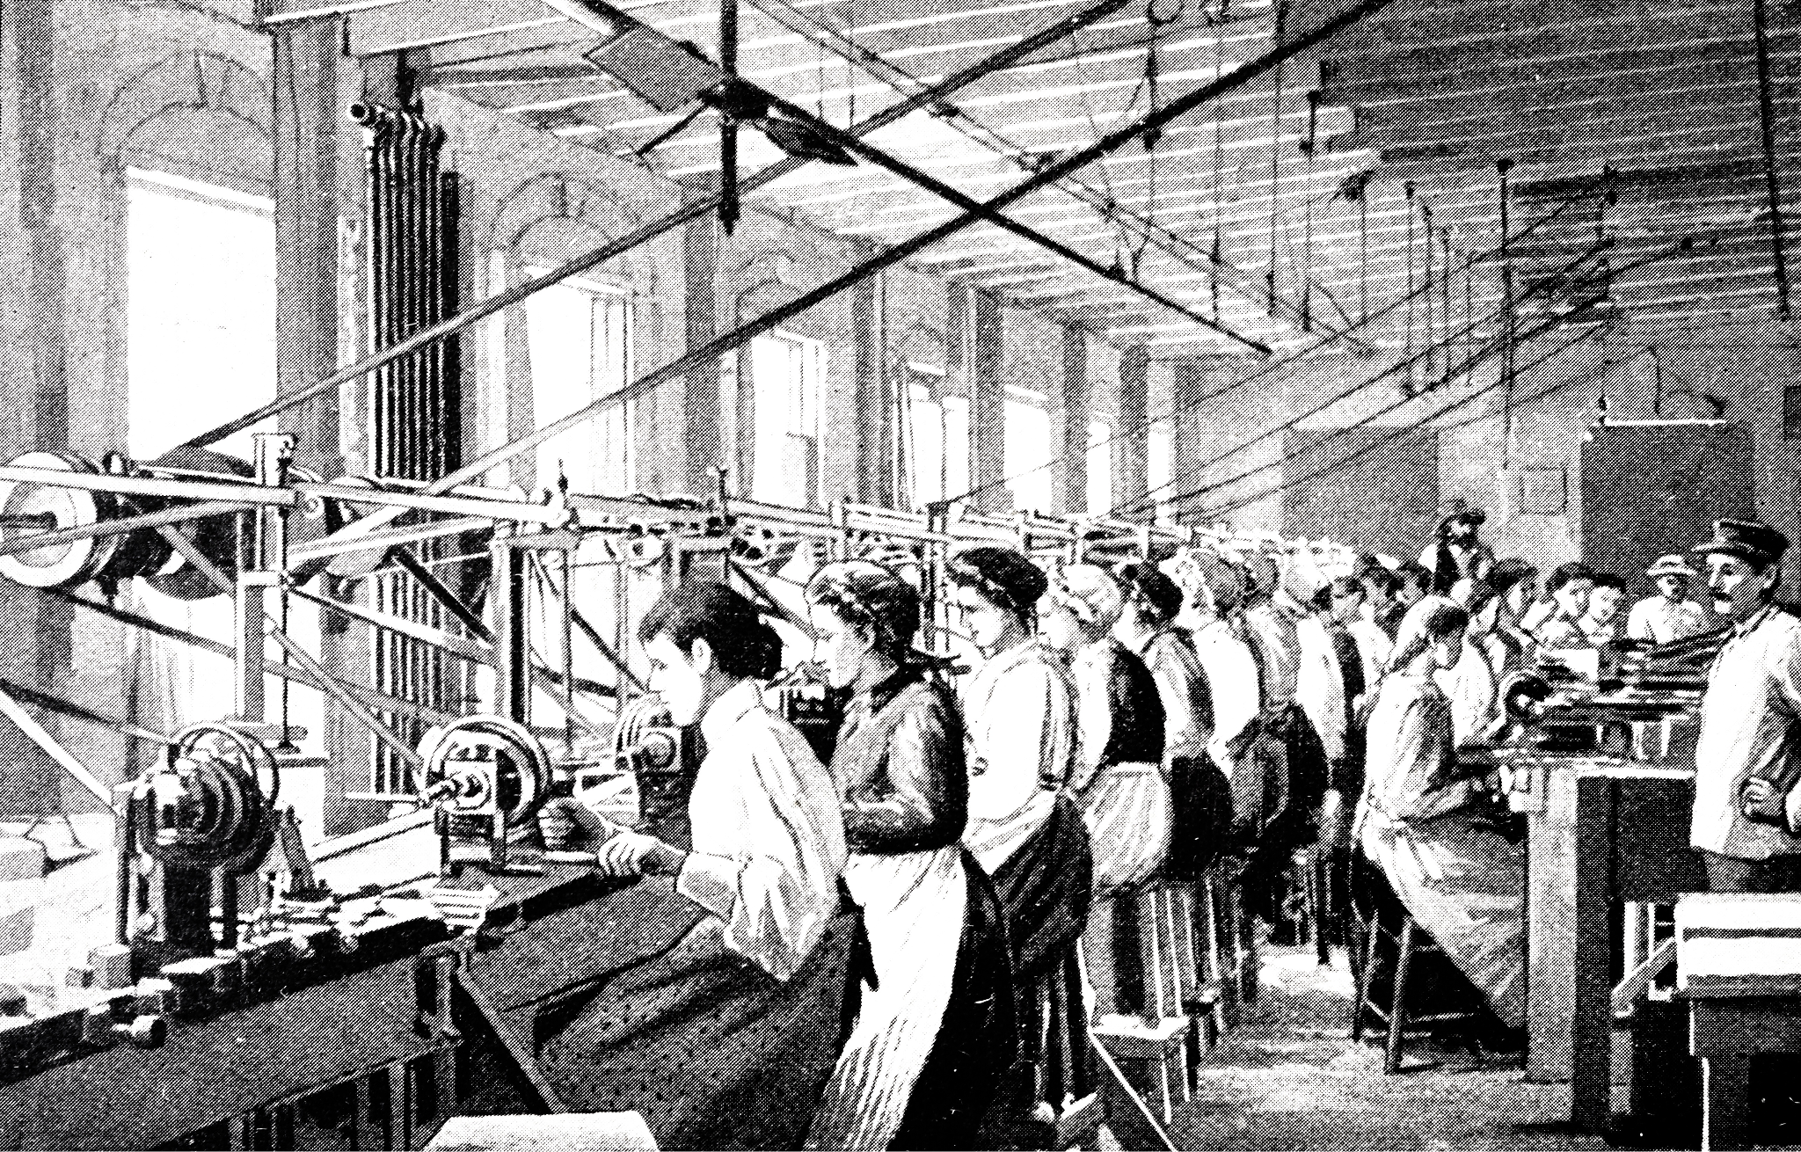

Slide 25

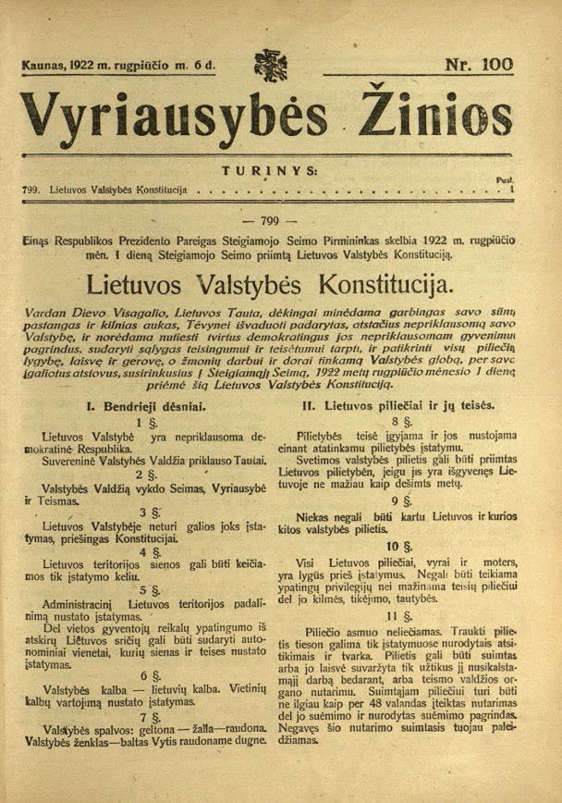
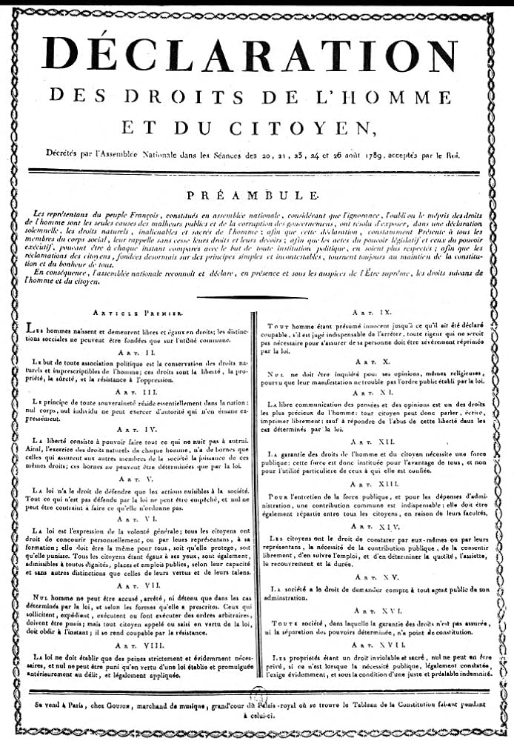

Slide 26


New whitepaper
> v1.0 published this week
> v2.0 over the summer
Contribute!
www.ilves.ai/agenticstate

Slide 27
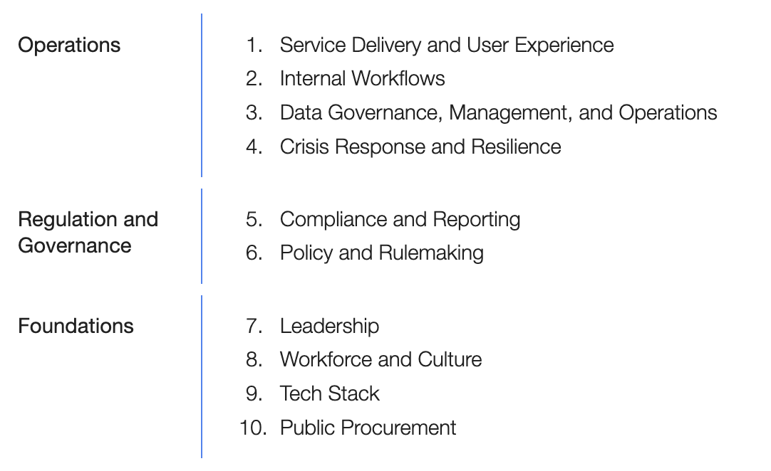
A Blueprint for Transformation of Government and Public Administration

Slide 28
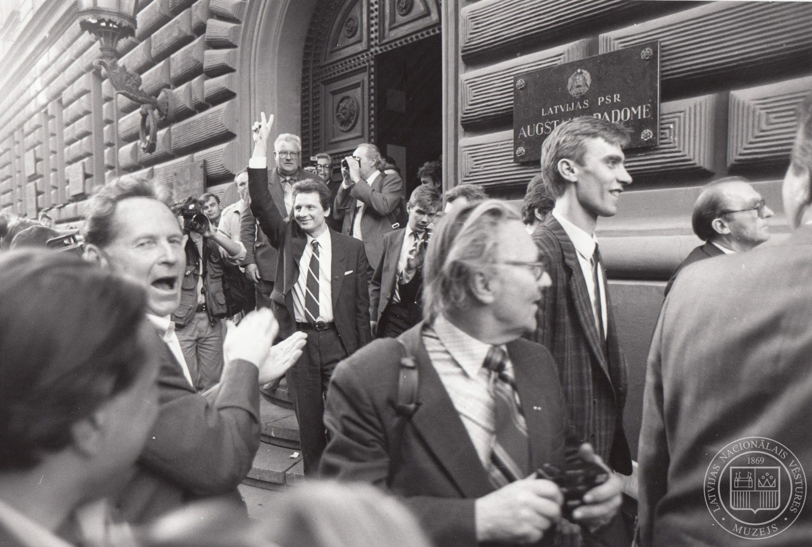
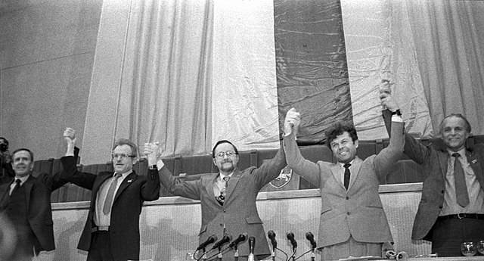
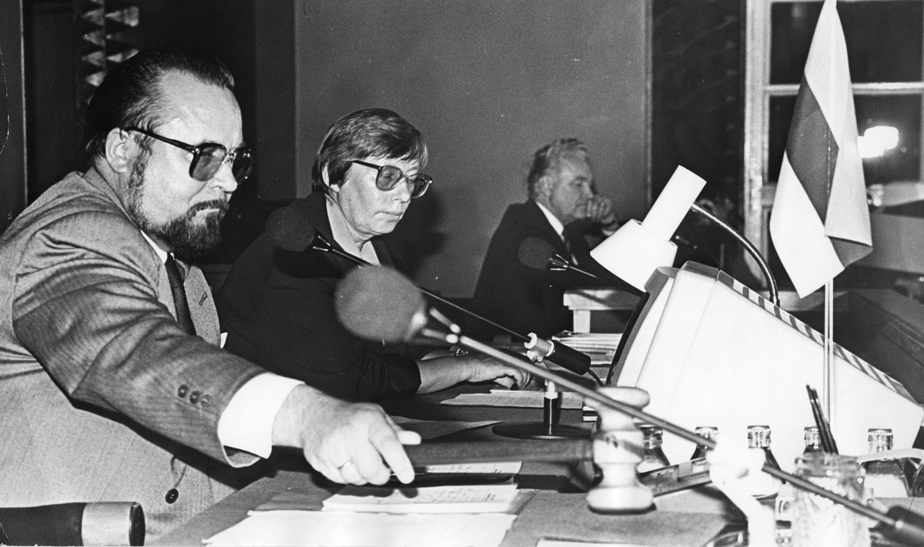

Slide 29
ačiū!
Luukas@ilves.ai
www.ilves.ai/publications

